Slide 1
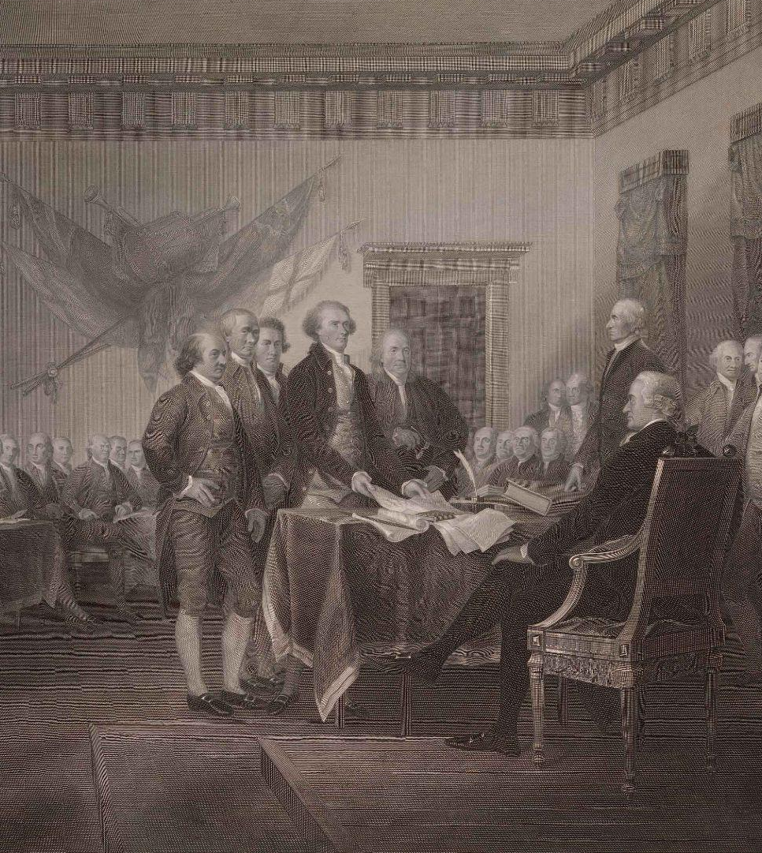

Liberty or Loyalty: What Will You Decide?

Slide 2
Liberty or Loyalty?
Liberty or Loyalty is a role-playing game in which students take on the position of members of the British North American colonies in the years 1763 to 1775.
As new taxes and laws are implemented and escalating crises unfold, students will have to decide whether they will remain loyal to England or declare independence.

Slide 3
What are Liberty Points?
Liberty Points stand for freedom
Each colony begins play with 5 Liberty Points
You earn or lose Liberty Points when you comply or resist the action of King George III
When the final vote is taken to declare independence, the number of Liberty Points you have will support you in deciding to declare liberty or remain loyal

Slide 4
Day 1: Liberty Points
Comply
Resist
“You choose to stay loyal
to the Crown and reject
calls for rebellion.”
-1 Liberty Point
Roll the Dice
Roll 1-3
“Your efforts at
resistance upset fellow
colonists who become
stronger supporters of
the Crown.”
-2 Liberty Points
Roll 4-6
“Your efforts at
resistance bring others
to the cause.”
+1 Liberty Point

Slide 5
Day 2: Liberty Points
Comply
Resist
“You choose to stay loyal
to the Crown and reject
calls for rebellion.”
-2 Liberty Point
Roll the Dice
Roll 1-3
“Your efforts at
resistance upset fellow
colonists who become
stronger supporters of
the Crown.”
-3 Liberty Points
Roll 4-6
“Your efforts at
resistance bring others
to the cause.”
+2 Liberty Point

Slide 6
Game Play Expectations
You are now members of colonial groups. Each group represents a different colony. You must make decisions together as we move through the game.
Remember that:
You are on the same team.
Communicate with patience.
Everyone in the group deserves a chance to speak.

Slide 7
-Large landowner who want to increase property holdings
-Small farmers who want bigger farms west of Appalachians
-Veterans who expected land in the west as a reward for their service
-Merchants who supply pioneers and farmers
Proclamation of 1763
Day 1 Card
What This Law Does:
Who It Affects:
Colonists wanting to settle west of the Appalachian Mountains can no longer negotiate with Native Americans themselves
Only the colonial assemblies can enter into land purchases with Native Americans

Slide 8
Proclamation of 1763: Consequences
Day 1 Card
Resist: Move west or support those who do without the Crown or colonial assemblies’ support.
Comply: Stay east of the mountains and give up those lands.
Roll 1-3
“Your efforts at
resistance upset fellow
colonists who become
stronger supporters of
the Crown.”
-2 Liberty Points
Roll 4-6
“Your efforts at
resistance bring others
to the cause.”
+1 Liberty Point
“You choose to stay loyal to the Crown and reject calls for rebellion.”
-1 Liberty Point

Slide 9
-Families buying household goods
-Shop owners who sell these items
-Those who ship these goods
-The people who use these items to create other products
Day 1 Card
Townshend Acts (1767)
What This Law Does:
Who It Affects:
-Colonists will have to pay more for imported items, including basic goods.
-Money raised by the taxes will pay the salaries of the colonial royal governors.

Slide 10
Townshend Acts (1767): Consequences
Day 1 Card
Resist: Boycott (refuse to buy) the taxed goods. If you resist, you roll the dice.
Comply: Keep buying the taxed items.
Roll 1-3
“Your efforts at
resistance upset fellow
colonists who become
stronger supporters of
the Crown.”
-2 Liberty Points
Roll 4-6
“Your efforts at
resistance bring others
to the cause.”
+1 Liberty Point
“You choose to stay loyal to the Crown and reject calls for rebellion.”
-1 Liberty Point

Slide 11
-Merchants who import goods.
-Families buying sugar and other related goods.
-Workers in port cities and trade towns.
Day 1 Card
Sugar Act (1764)
What This Law Does:
Who It Affects:
-Colonists will have to pay more for imported items, including sugar, molasses, rum, and other sugar-related products.
-Money raised by the taxes will help to pay the debt created by the French and Indian War.

Slide 12
Day 1 Card
Sugar Act (1764)
Resist: Boycott, protest, or try to smuggle goods to avoid the taxes. If you resist, you roll the dice.
Comply: Pay the reduced taxes on sugar and sugar-related goods.
Roll 1-3
“Your efforts at
resistance upset fellow
colonists who become
stronger supporters of
the Crown.”
-2 Liberty Points
Roll 4-6
“Your efforts at
resistance bring others
to the cause.”
+1 Liberty Point
“You choose to stay loyal to the Crown and reject calls for rebellion.”
-1 Liberty Point

Slide 13
-Printers and those who run newspapers
-Lawyers and business owners
-Farmers and shippers who make use of contracts
-Virtually everyone
Day 1 Card
Stamp Act (1765)
What This Law Does:
Who It Affects:
Colonists will have to pay for
officially stamped paper, which
will cause things like
newspapers, licenses, legal
papers, contracts, and, even,
playing cards, to cost
more.
Money raised by the taxes will
help to pay the debt created by
the French and Indian War.

Slide 14
Day 1 Card
Stamp Act (1765)
Resist: Refuse the stamps, protest, and boycott British goods. If you resist, you roll the dice.
Comply: Use the stamped paper and pay the tax.
Roll 1-3
“Your efforts at
resistance upset fellow
colonists who become
stronger supporters of
the Crown.”
-2 Liberty Points
Roll 4-6
“Your efforts at
resistance bring others
to the cause.”
+1 Liberty Point
“You choose to stay loyal to the Crown and reject calls for rebellion.”
-1 Liberty Point

Slide 15
-Inn and public house owners
-Merchants who sell basic goods and supplies
-Farmers with large barns
-Communities near where troops will be stationed
Quartering Act (1765)
Day 1 Card
What This Law Does:
Who It Affects:
-Colonists, through their colonial
assemblies, will have to pay for
food, supplies, and housing for
the Royal Army troops.
-These soldiers will be housed in public buildings, possibly barns.
-Merchants will be paid reasonable prices for the goods
necessary to outfit the troops.

Slide 16
Quartering Act (1765)
Day 1 Card
Resist: Refuse to provide the support required by the law and protest the stationing of additional troops.
Comply: Provide the housing and supplies required by the soldiers.
Roll 1-3
“Your efforts at
resistance upset fellow
colonists who become
stronger supporters of
the Crown.”
-2 Liberty Points
Roll 4-6
“Your efforts at
resistance bring others
to the cause.”
+1 Liberty Point
“You choose to stay loyal to the Crown and reject calls for rebellion.”
-1 Liberty Point

Slide 17
-Individuals living in and around the Boston area
-Patriots and Loyalists each have a different understanding of what happened and why
-Anyone worried that violence could spread
Day 2 Card
Boston Massacre (1770)
What This Law Does:
Who It Affects:
-This is not a new tax or a law, per se. This is a serious event occurring in the colonies because of growing tensions between Patriots and the Crown.
-In total, five people die and eight more are wounded.

Slide 18
Boston Massacre (1770)
Day 2 Card
Comply: Stay loyal to the Crown. Reject violence on both sides but believe that this incident was caused by the protesters.
Resist: Call for an end to the violence, which you believe was caused by the soldiers. Demand the King stop the attacks on civilians. If you resist, roll the dice.
“You choose to stay loyal to the Crown and reject calls for rebellion.”
-2 Liberty Point
Roll 1-3
“Your efforts at
resistance upset fellow
colonists who become
stronger supporters of
the Crown.”
-3 Liberty Points
Roll 4-6
“Your efforts at
resistance bring others
to the cause.”
+2 Liberty Point

Slide 19
-Most families who enjoy tea as a regular dink
-Shop owners who sell tea, whether they have a license with the British East India Company or not
-Tea smugglers
Day 2 Card
Tea Act (1773)
What This Law Does:
Who It Affects:
-Tea is among the most favorite drinks of the empire, and the colonies.
-The act gives the British East India Company a monopoly on tea sales to the colonies, while also cutting the taxes on tea.
-Tea prices go down, but the law restricts who can sell tea and harms those getting rich in the smuggling of foreign tea.

Slide 20
Tea Act (1773)
Day 2 Card
Resist: Boycott tea and take a stand against the implied power of the Crown to issue new taxes without colonial consent. If you resist, roll the dice.
Comply: Buy the cheaper tea and enjoy the fruits of living in a global empire.
“You choose to stay loyal to the Crown and reject calls for rebellion.”
-2 Liberty Point
Roll 1-3
“Your efforts at
resistance upset fellow
colonists who become
stronger supporters of
the Crown.”
-3 Liberty Points
Roll 4-6
“Your efforts at
resistance bring others
to the cause.”
+2 Liberty Point

Slide 21
-Individuals living in and around the Boston area
-Patriots and Loyalists who each have a different understanding of what happened and why
-Merchants (tea or otherwise) who might fear their supplies could be targeted next
-Anyone worried about the possible increase in violence
Boston Tea Party (1773)
What This Law Does:
Who It Affects:
-This is not a new tax or a law, per se. This is a serious event occurring in the colonies as a result of the growing tensions between Patriots and the Crown.
-In total, 342 chests of tea (roughly 46 tons) were thrown overboard, costing nearly $4 million in today’s money.

Slide 22
Day 2 Card
Boston Tea Party (1773)
Resist: Support the actions of the Sons of Liberty—call for an end to taxation without representation. If you resist, roll the dice.
Comply: Stay loyal to the Crown—reject the senseless destruction of the tea and call for the Sons of Liberty to be arrested.
Roll 1-3
“Your efforts at
resistance upset fellow
colonists who become
stronger supporters of
the Crown.”
-3 Liberty Points
Roll 4-6
“Your efforts at
resistance bring others
to the cause.”
+2 Liberty Point
“You choose to stay loyal to the Crown and reject calls for rebellion.”
-2 Liberty Point

Slide 23
-Individuals living in and around the Boston area—actually, all of Massachusetts
-Merchants, shippers, and dockworkers who rely on the port of Boston
-Families who may need to pay higher prices for goods because of slower trade
-Colonists who supported self-government through their elected assemblies
Day 2 Card
Intolerable Acts (1774)
What This Law Does:
Who It Affects:
-There are several different laws passed all at once. They do a range of things from close the port of Boston to expanding the power of the royal governors.
-They also limit or remove colonial assemblies and strengthen the power of the military to enforce laws.

Slide 24
Day 2 Card
Intolerable Acts (1774)
Resist: Push back against the restrictions and demand colonial assemblies be restored. If you resist, roll the dice.
Comply: Accept the new restrictions—seeing them as the result of the rebels—and obeying the new laws.
“You choose to stay loyal to the Crown and reject calls for rebellion.”
-2 Liberty Point
Roll 1-3
“Your efforts at
resistance upset fellow
colonists who become
stronger supporters of
the Crown.”
-3 Liberty Points
Roll 4-6
“Your efforts at
resistance bring others
to the cause.”
+2 Liberty Point

Slide 25
-Individuals living in and around Lexington and Concord—Massachusetts in general
-Militia members and farmers
-Families worried about safety and war
Day 2 Card
Lexington & Concord (1775)
What This Law Does:
Who It Affects:
-This is not a new tax or a law, per se. This is a serious event occurring in the colonies as a result of the growing tensions between patriots and the Crown.
-In the end, several hundred people are wounded or die from the fighting this day.

Slide 26
Day 2 Card
Lexington & Concord (1775)
Comply: Support the Army’s mission to collect the weapons and arrest the leaders of the rebellion.
Resist: Support the rebels’ right to have weapons to defend themselves against an increasingly tyrannical government. If you resist, roll the dice.
“You choose to stay loyal to the Crown and reject calls for rebellion.”
-2 Liberty Point
Roll 1-3
“Your efforts at
resistance upset fellow
colonists who become
stronger supporters of
the Crown.”
-3 Liberty Points
Roll 4-6
“Your efforts at
resistance bring others
to the cause.”
+2 Liberty Points

Slide 27
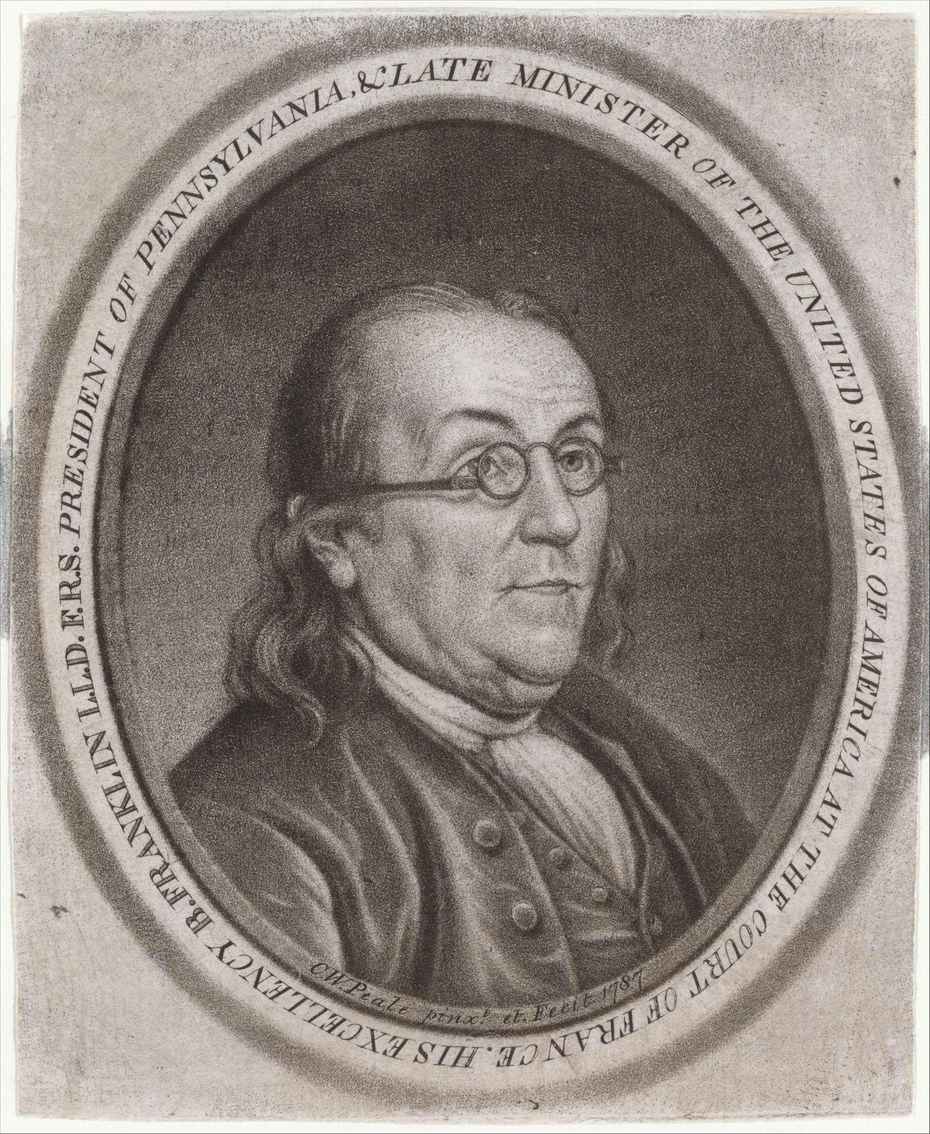

Mini-Debate

Slide 28
Time for Decisions
Look at each colony’s points : Liberty Points represent your Freedom. Look carefully at the numbers.
If your colony has very little freedom, how does it feel?
If your colony has some freedom, is it enough?

Slide 29
Time for Decisions
Discuss/debate: Do you have enough freedom to remain loyal or is liberty the only path?
    Sentence stems:
    We should sign because …
    We should remain loyal because …
    Britain has taken away our right to …
    Breaking away could cause …

Slide 30
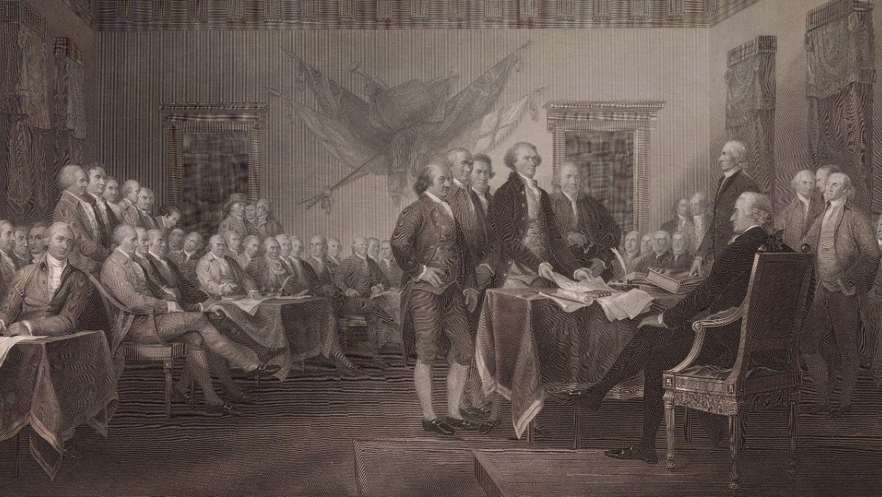

Will you sign?

