Slide 1
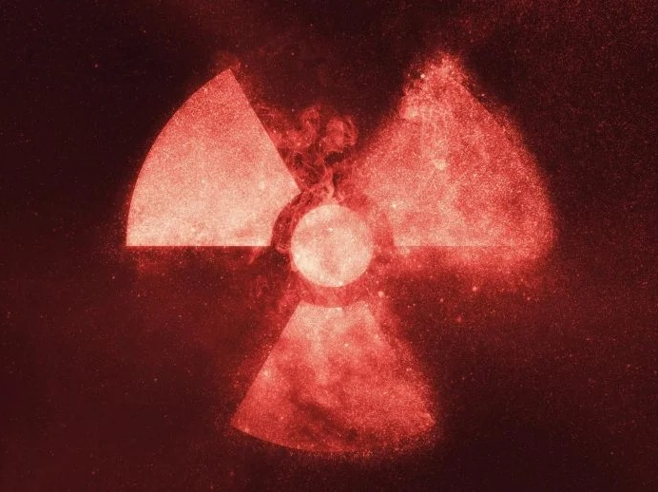




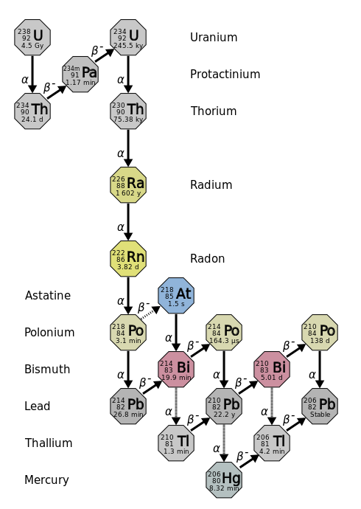
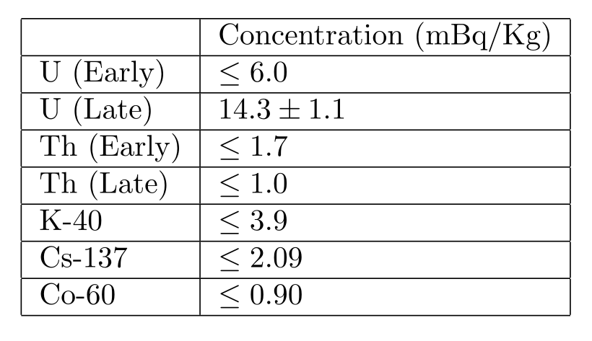
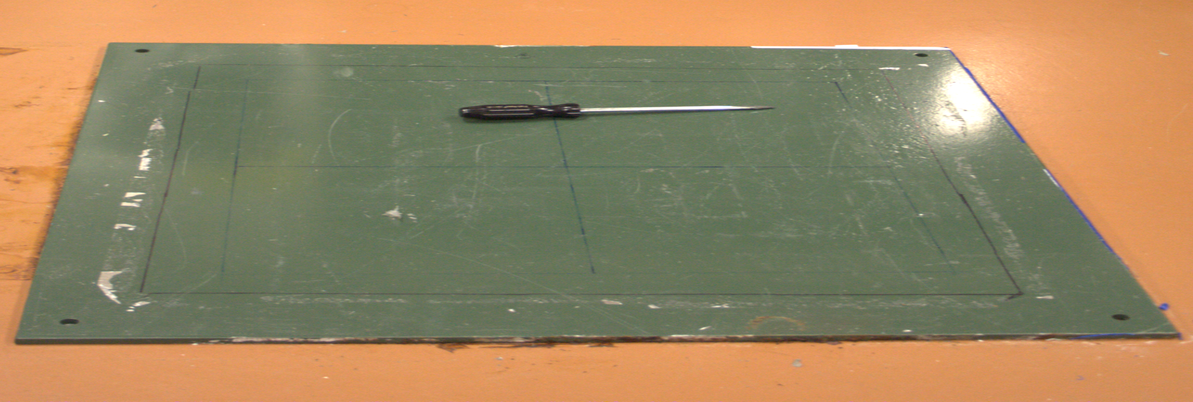
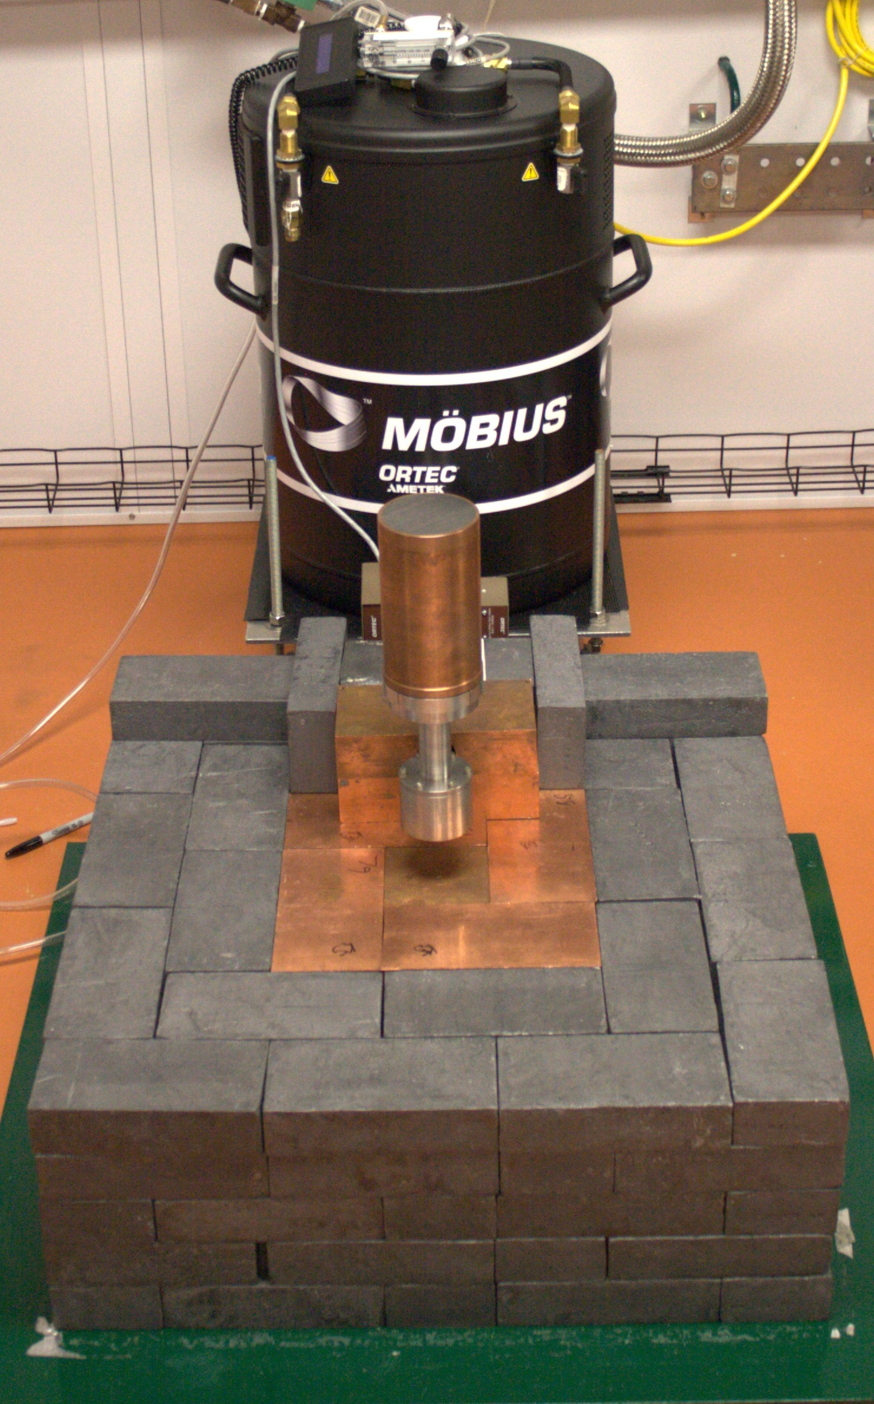
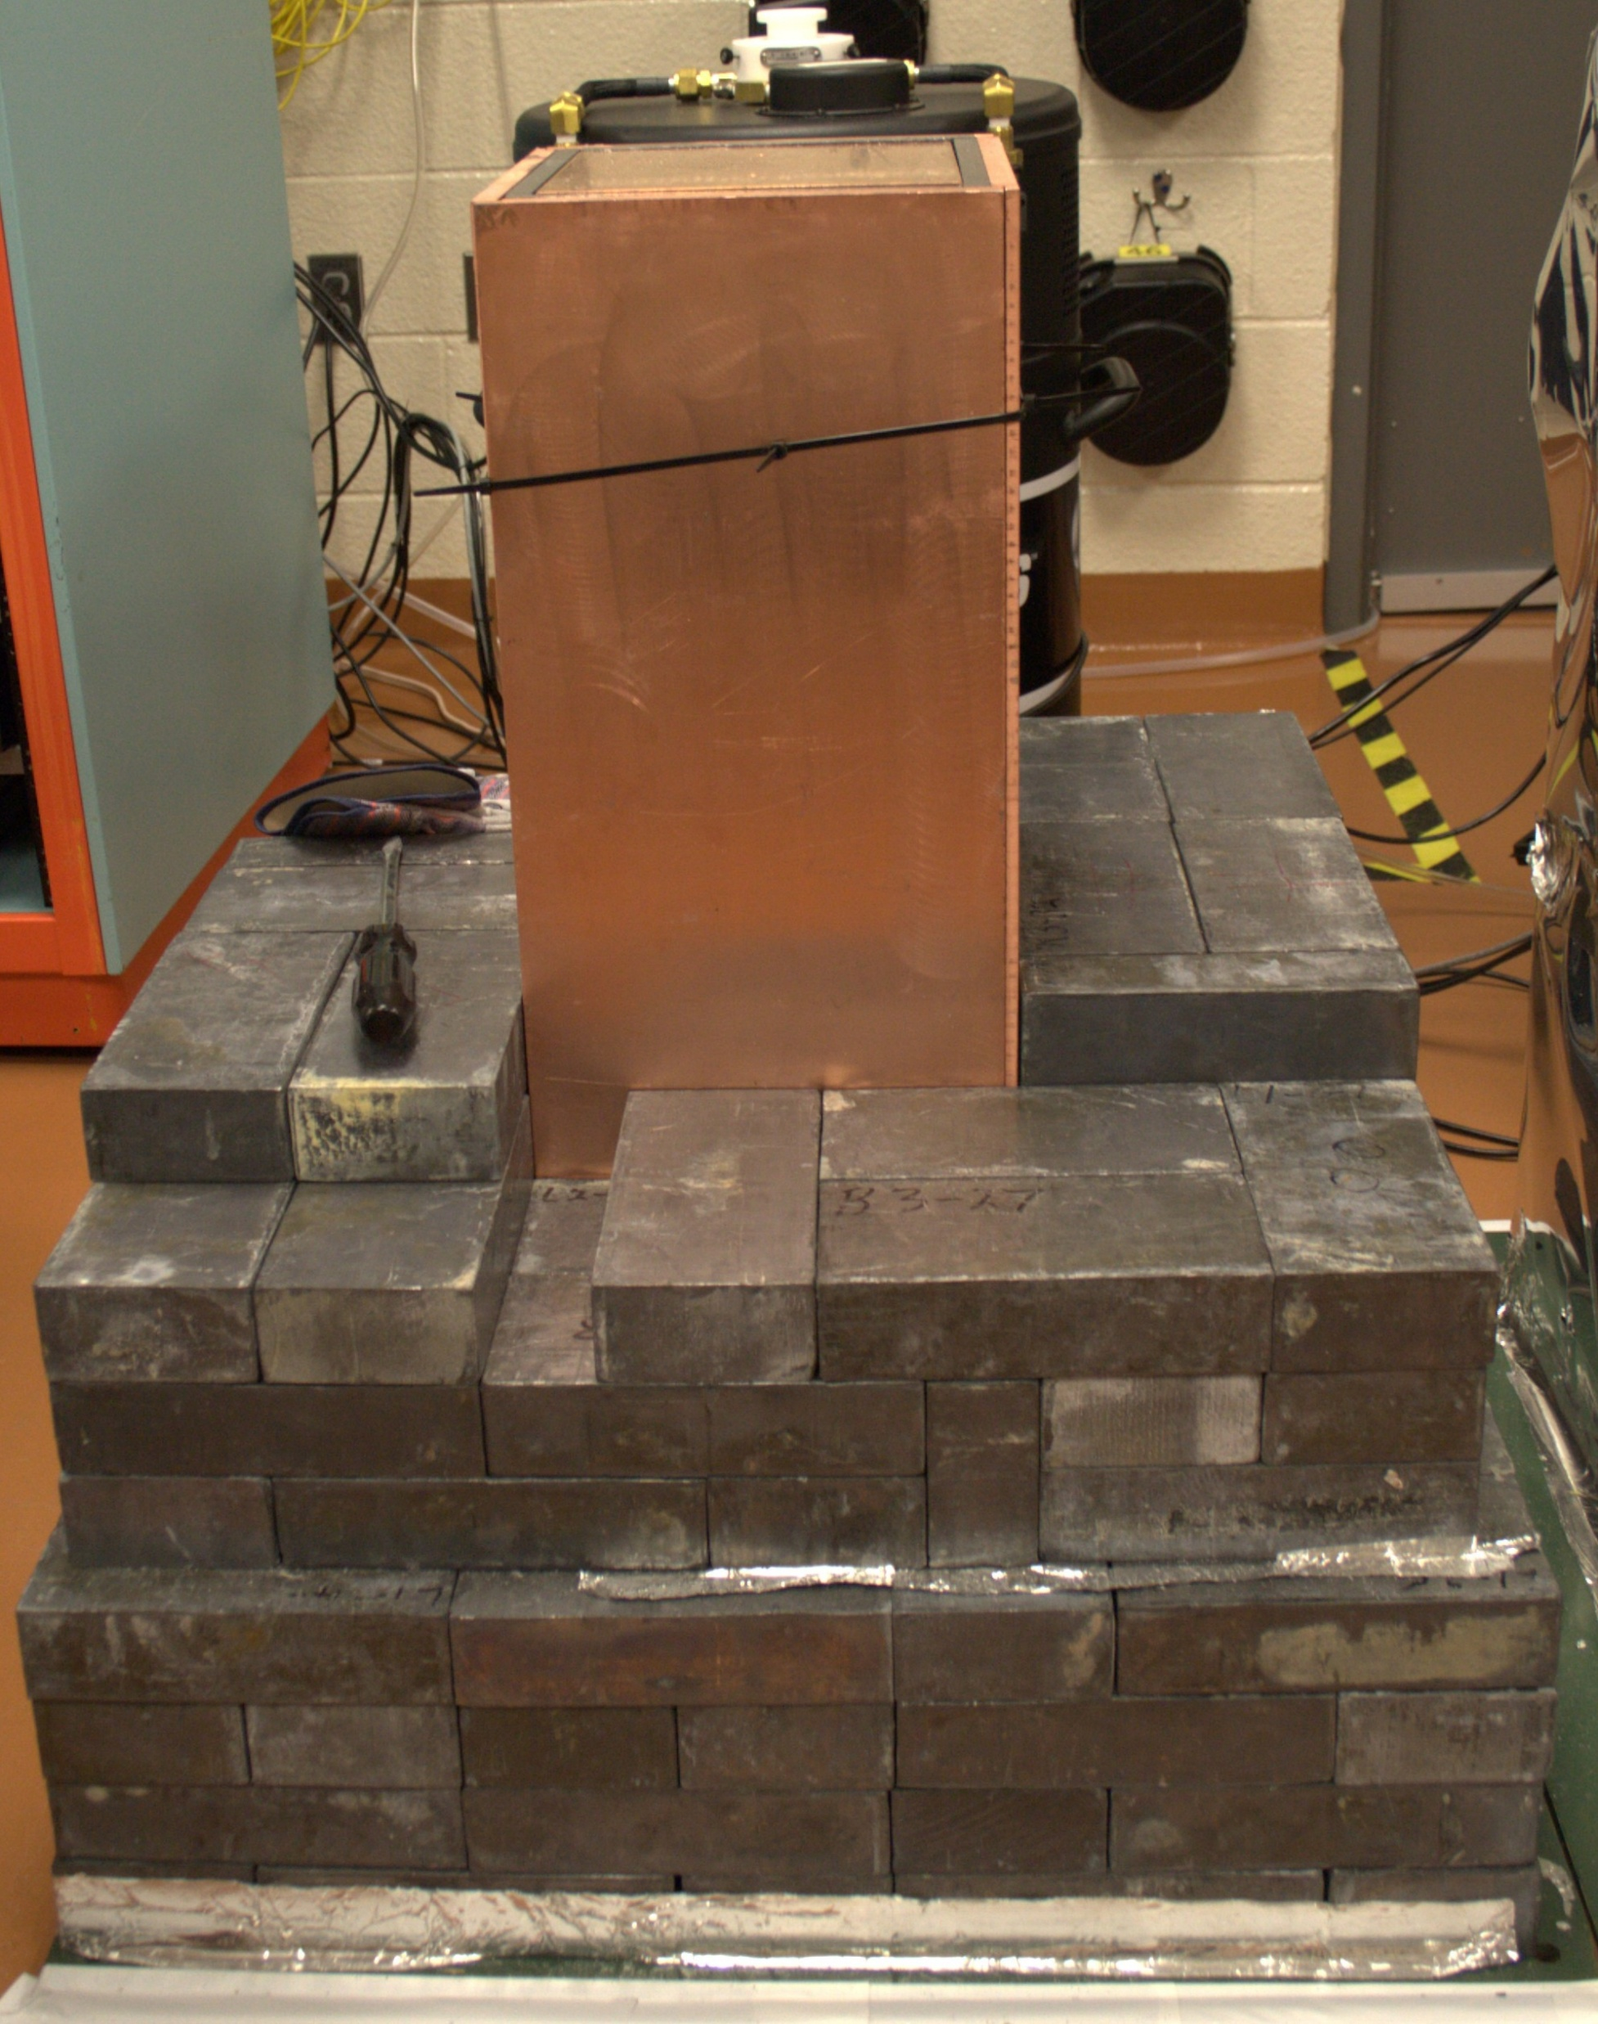
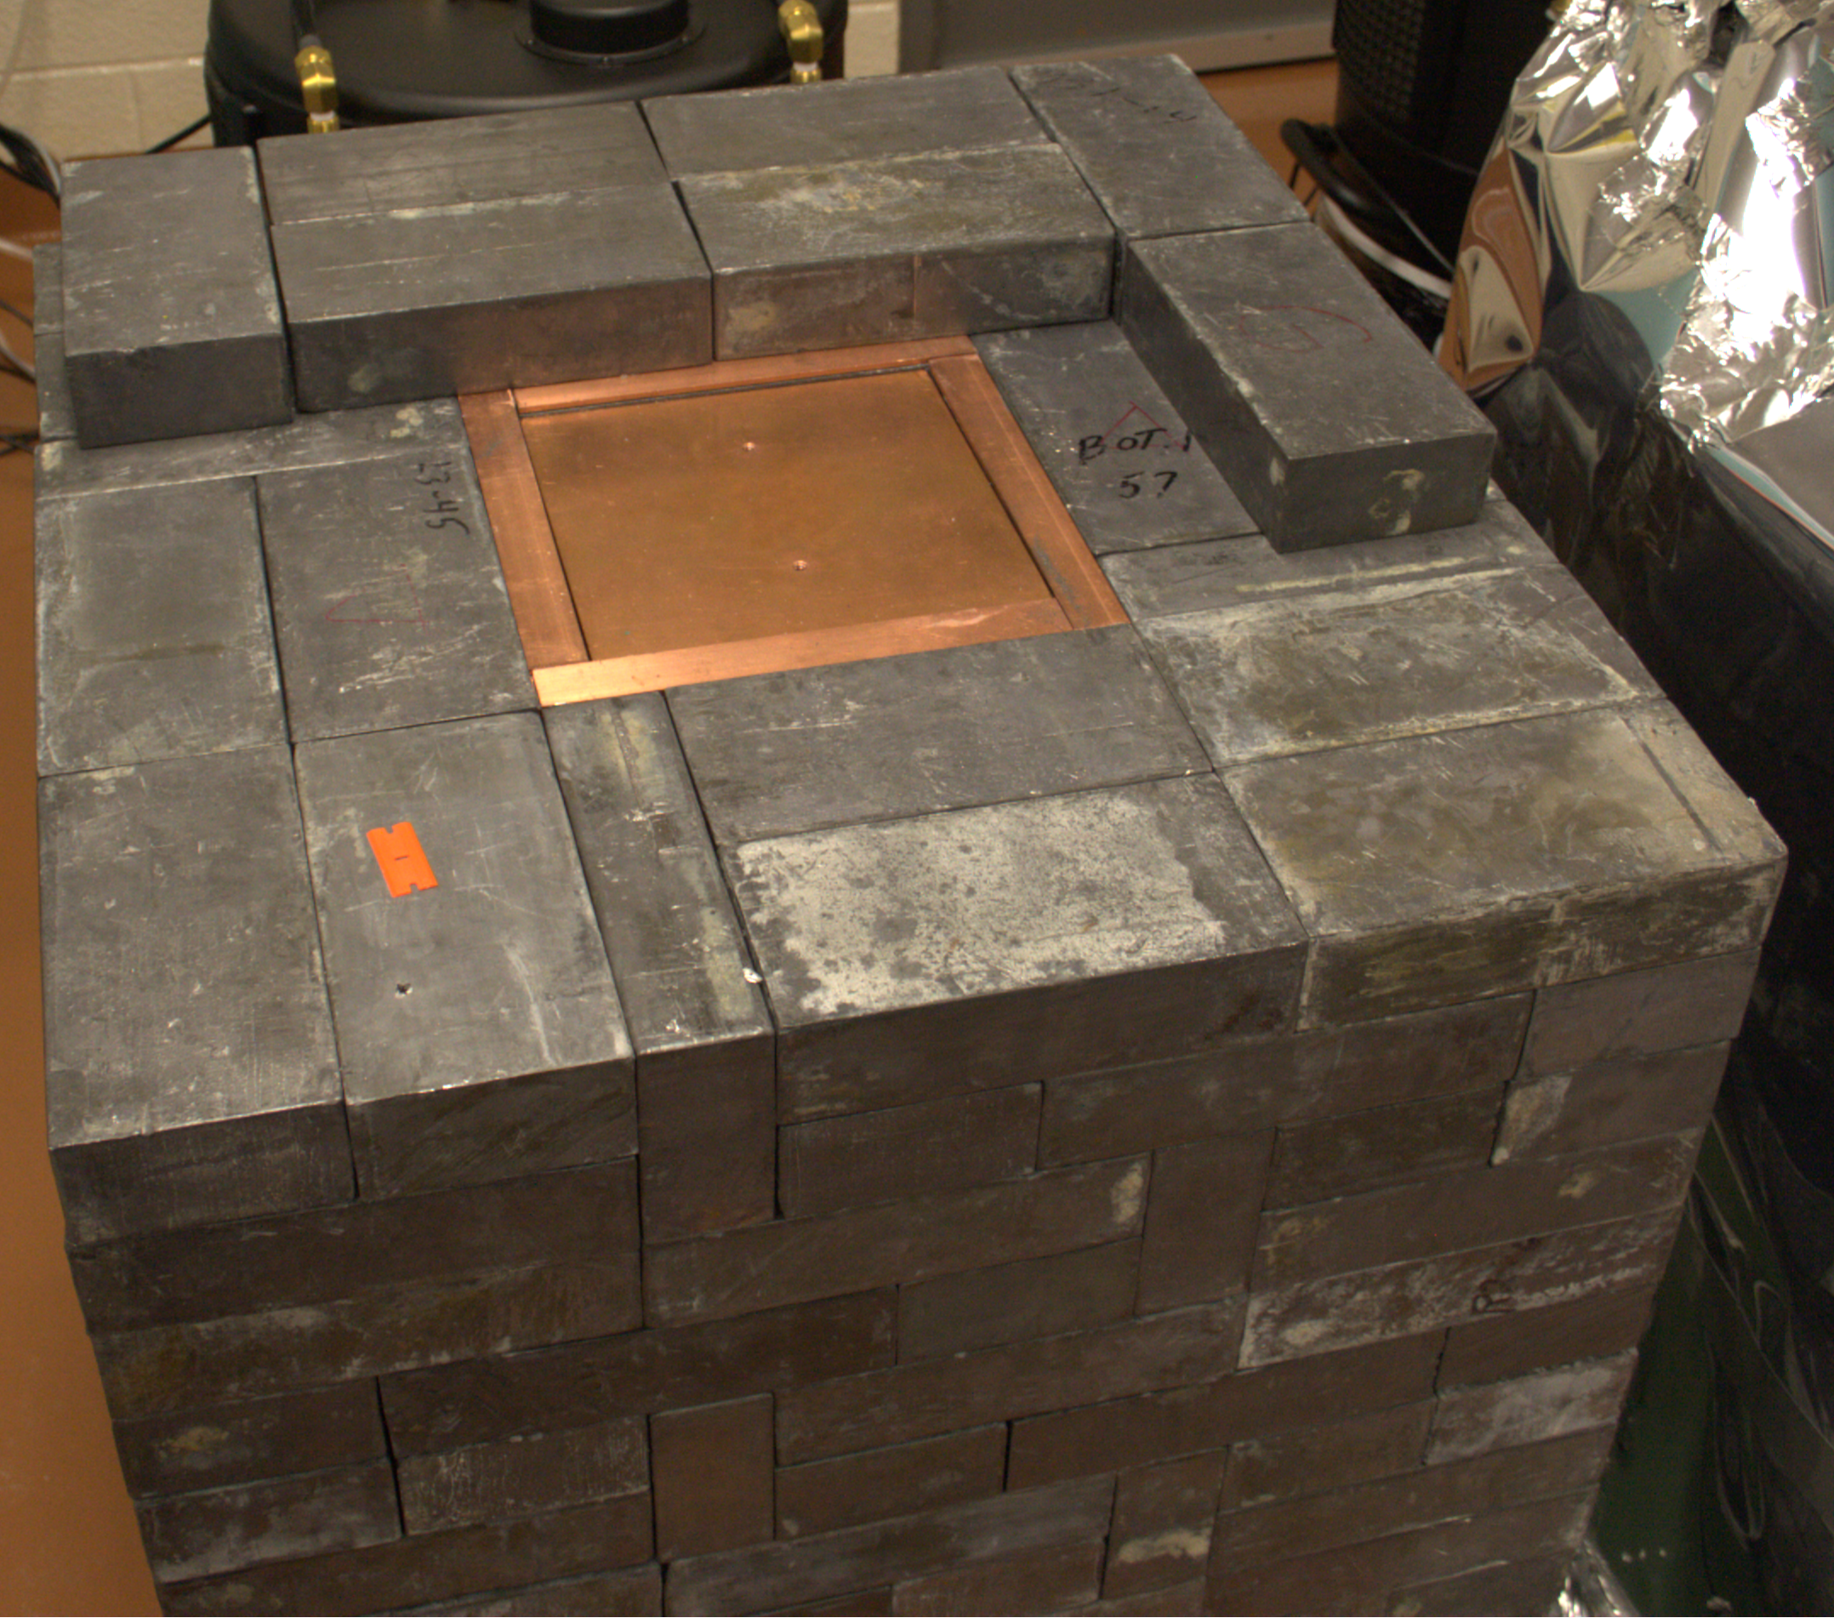
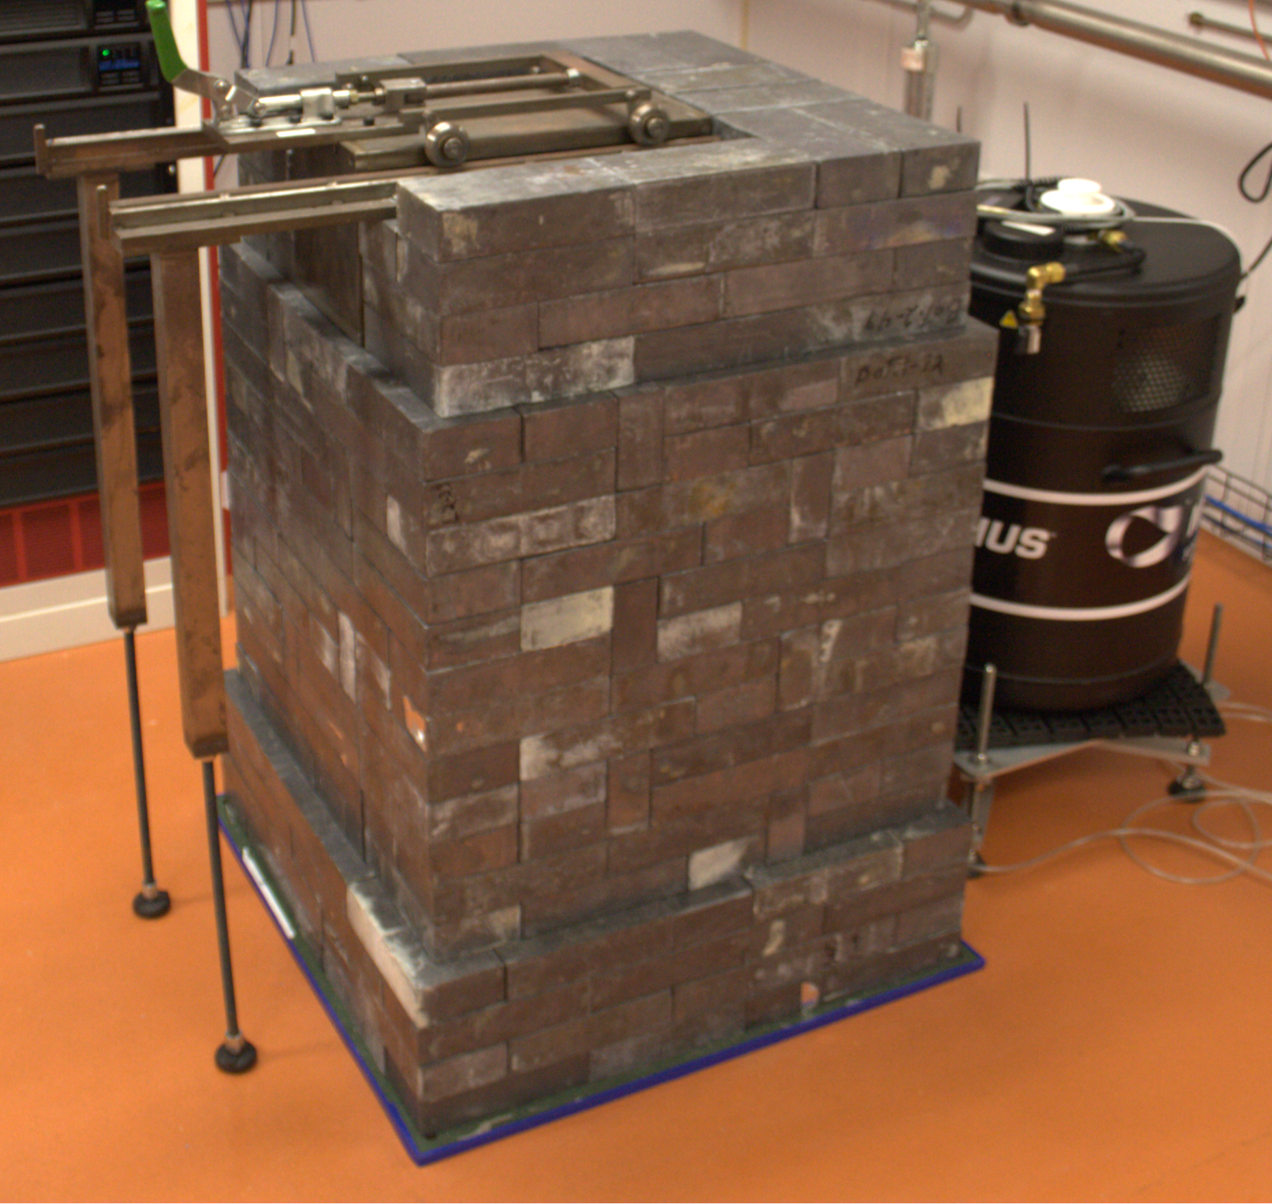
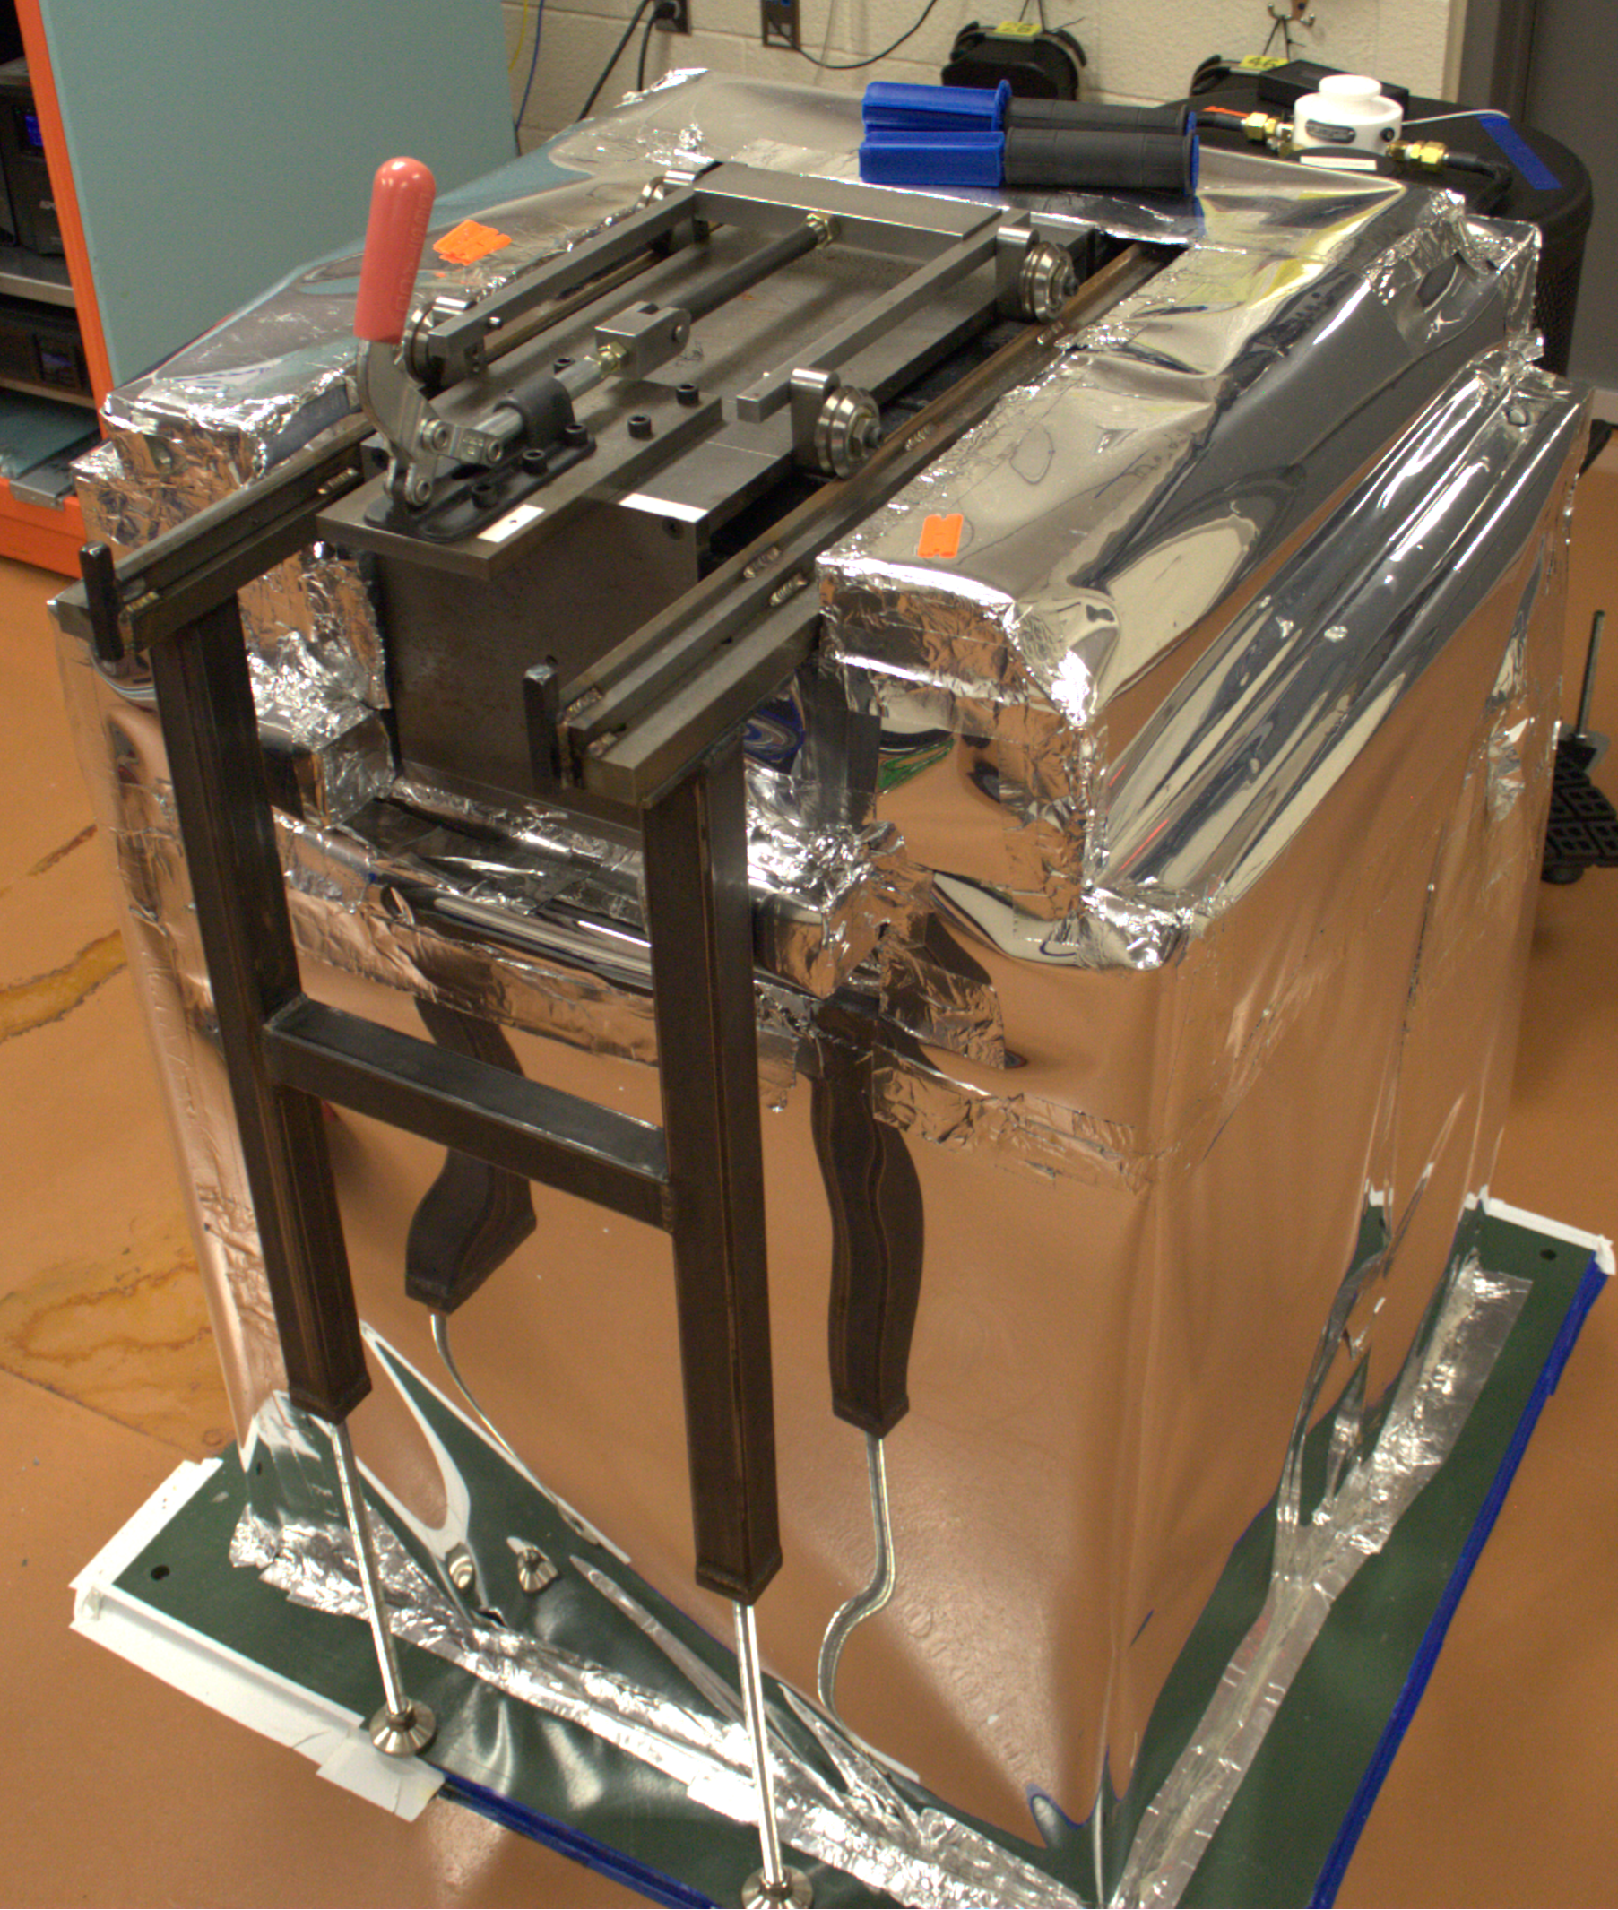
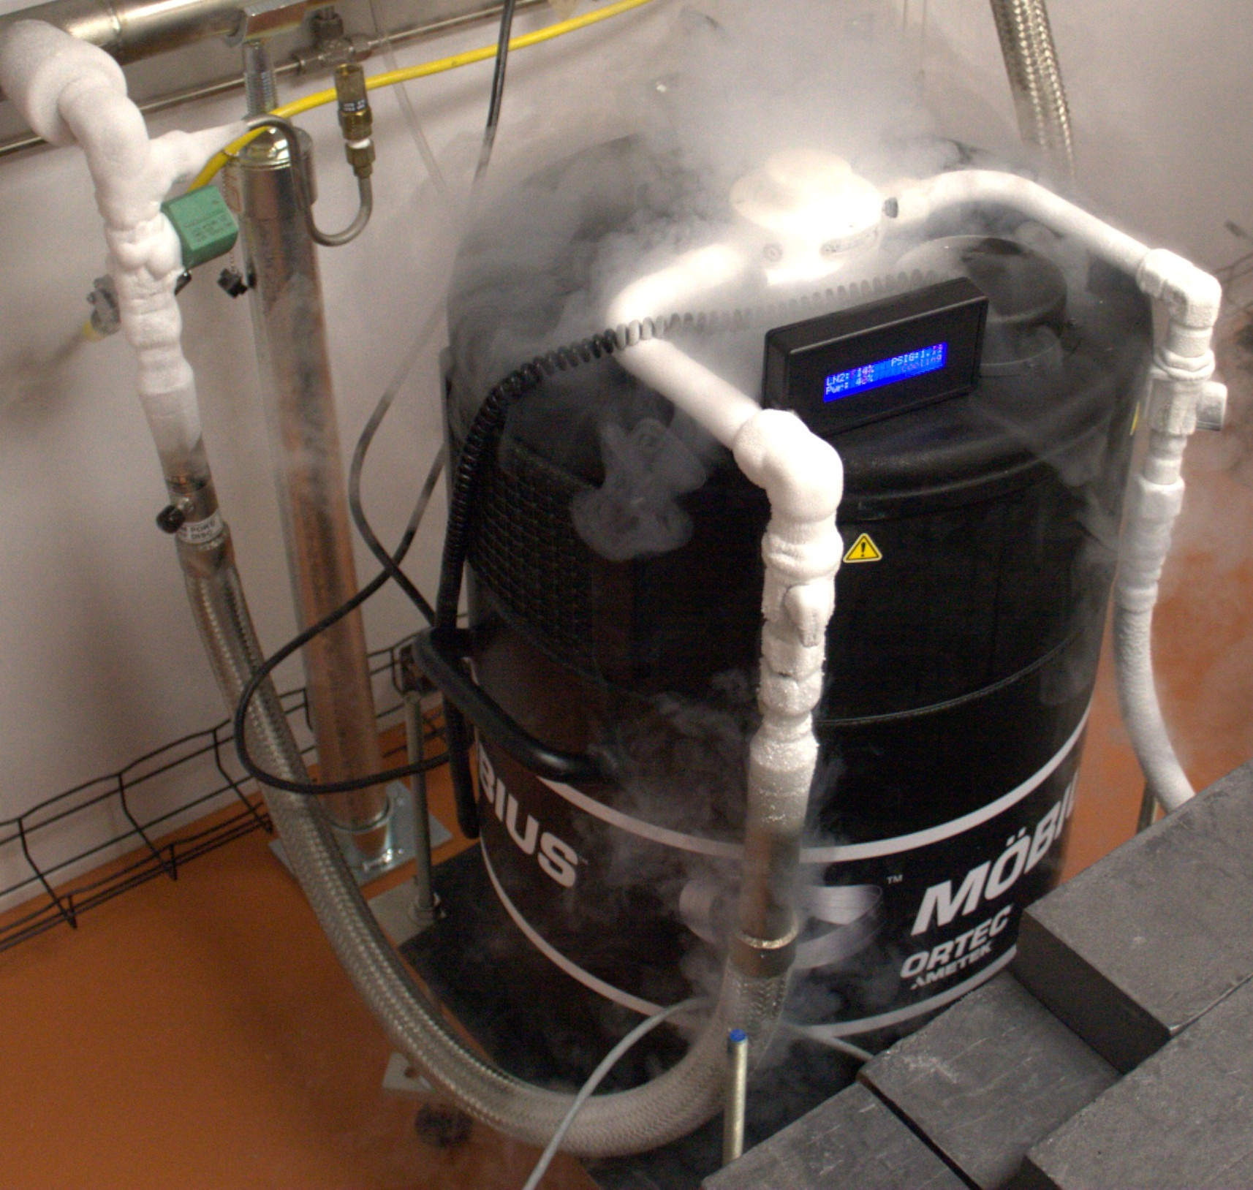
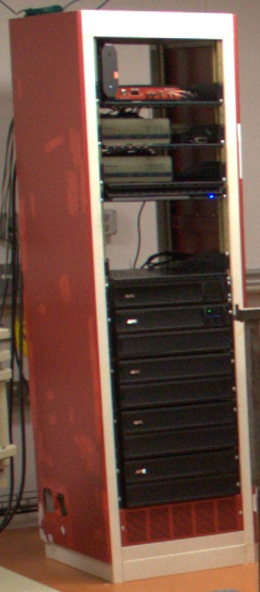
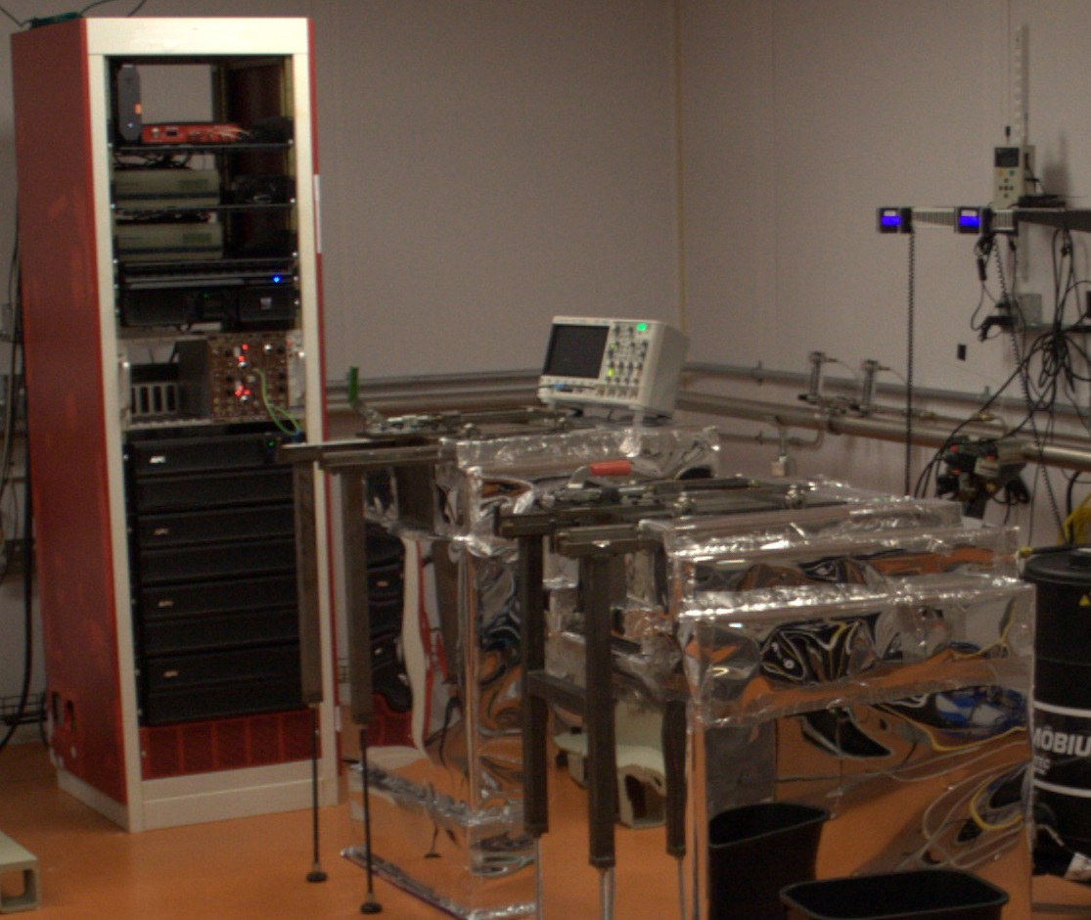
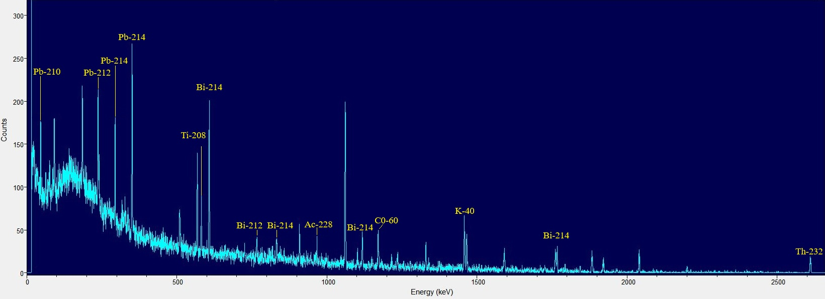
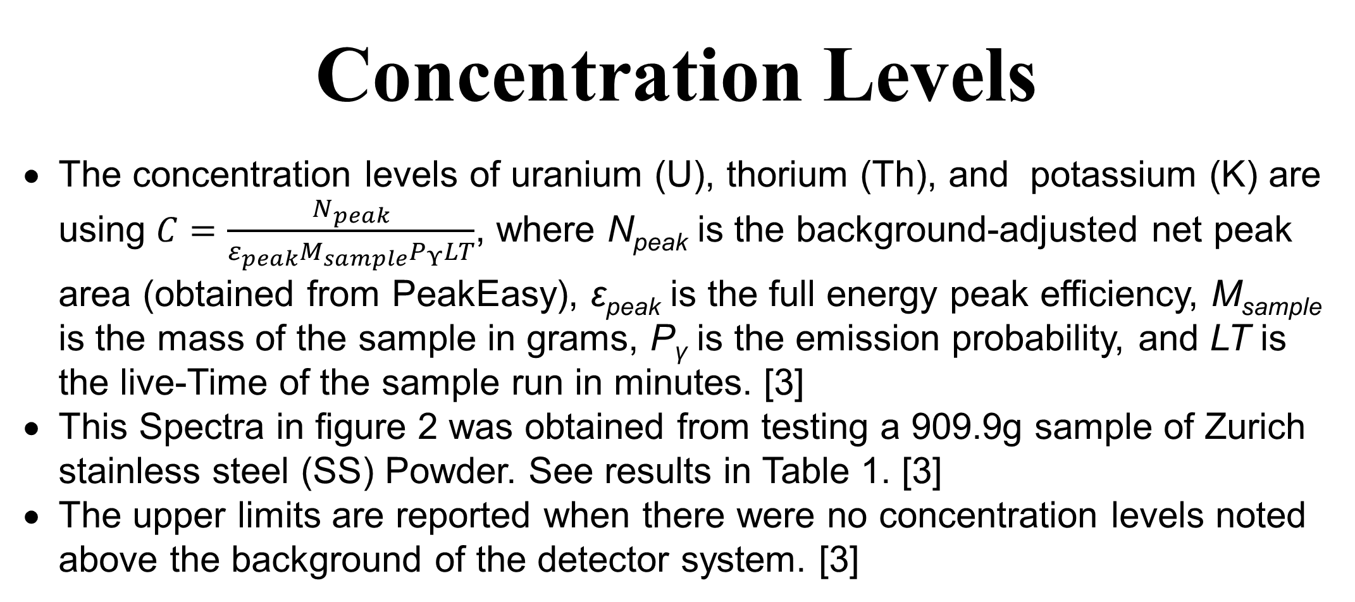
High Purity Germanium Background Radiation Detectors
Nicholas Bearer (1), Brianna Mount (2), Foster Carroll (3), Katie Pedneau (2)
(1) Texas A&M University Corpus Christi (2) Black Hills State University (3) Carleton College
Location, Location, Location!
Detecting a material’s background radiation at such a small scall requires a lot of shielding from other sources. So, we use the earth to provide the majority of that shielding. Underground located at the Sanford Underground Research Facility (SURF) is where these experiments are taking place. More specifically, at the Black Hills Underground Campus (BHUC) one mile underground, 4850L to be exact.
Concentration Levels
The concentration levels of uranium (U), thorium (Th), and potassium (K) are using $C=\frac{N_{peak}}{ε_{peak}M_{sample}P_{Υ}LT}$, where N_{peak} is the background-adjusted net peak area (obtained from PeakEasy), ε_{peak} is the full energy peak efficiency, M_{sample} is the mass of the sample in grams, P_{γ} is the emission probability, and LT is the live-Time of the sample run in minutes. [3]
This Spectra in figure 2 was obtained from testing a 909.9g sample of Zurich stainless steel (SS) Powder. See results in Table 1. [3]
The upper limits are reported when there were no concentration levels noted above the background of the detector system. [3]
Construction of a Germanium Detector
Each lead brick weighs approximately 26 pounds, and each detector uses roughly 500 bricks. As there are 4 detectors with lead brick shields, the total number of lead bricks is 2227. The total weight of lead bricks currently at the BHUC is around 57,902 pounds, not including the copper, detectors, or baseplates.
Building a low background counter at the BHUC begins with the baseplate. After the baseplate is placed in the desired location, a preset pattern of lead bricks is laid out on top. Each layer is stacked in a similar pattern but is alternated slightly to avoid creating any long seams. This provides stability and avoids any openings to the detector.
Around the 4th or 5th level of lead, the detector is brought in, and the Ga crystal is placed in the center with a small plastic tube placed under it. The crystal is surrounded with copper and the copper is surrounded by more layers of lead.
Reaching the top of the covering, the Sample space needs to be accessible but still covered by lead. This is where the door rails are placed which allows the copper lid to be covered by a wheeled lead-filled door.
Once the construction part is complete, the lead bricks are wrapped in mylar to prevent any radon gas from entering. The tube under the crystal is then connected to a nitrogen source to purge out any residual radon that may be lurking within the lead or around the crystal. The detector is then filled with liquid nitrogen and hooked up to the electrical systems. After allowing the crystal to cool, voltage is applied to the crystal. A background collection of data is begun and will last 30 days. Once the background collection is complete, an assay of Table Mountain Lattite (TML) is performed. This TML is a standard, or calibration sample used for determining the concentration levels of background radiation.
Forms of Decay
See Figure 1
Alpha: The release of a helium-4 nucleus, consisting of 2 protons and 2 neutrons from the original nucleus of an atom. [3]
Beta: The transformation of a neutron into a proton which ejects an electron (β⁻) and antineutrino (ῡ_{e}). [3]
Gamma: The release of energy from the daughter nucleus of an alpha or beta decay. [3]
Table 1: Overall Concentration Levels [4]
Acknowledgements
Doug Tiedt - For assistance with moving lead, selfless devotion to accomplishing any task, and willingness to help others understand.
Isabella Lopez - For assistance with moving lead, being an amazing team player, and never backing down from any obstacle, challenge, or task.
Olivia Cantrell - For assistance with moving lead, unwavering enthusiasm, and willingness to assist where she is needed.
Zachary Spangler - For assistance with moving lead, amazing wit, and dedication to any given task.
Dylan Chase - For assistance with moving lead, contagiously great attitude, and willingness to assist others.
Jay Hockhalter - For putting up with us and always making sure we were prepared for each day.
Robyn Varland - For always painting a brighter picture of the day and making sure we were prepared for the day.
NSF Award Number (2150517) - We thank the National Science Foundation for funding the REU students.
Figure 1: Uranium-238 Decay Chain [5]
Gamma Ray Detection Using
High-Purity Germanium Crystals
Germanium (Ga) crystals are reverse bias using 500 to 5000 volts, depending on quality. Higher quality crystals require less voltage to overcome impurities.[2]
Reverse bias creates an electric field that pulls all the electrons of the crystal’s lattice to the positive side of the crystal so the holes are located near the negative side of the crystal. With a hole on one side and an electron on the other, this creates an electron hole pair (EHP). This EHP separation is important because without it, the electrons would combine with the holes and any radiation event would not be recorded.[2]
How this works: Approximately 3 electron volts (eV) are required to produce a single EHP. A 1 MeV gamma ray can generate around 300,000 EHPs. If all the energy of a given gamma ray is absorbed into the Ga crystal, the EHP formations can be measured in the form of electrons. [2]
References
[1] Background Picture: https://scitechdaily.com/decades-of-scientific-theory
-disproven-beneficial-health-effects-found-from-high-background
-radiation-exposure/
[2] Baily, D. (Jan 2002), Advanced Undergraduate Laboratory, The
GermaniumSpectrometer
[3] G. R. Gilmore, G.R. (Apr 2008), Practical Gamma-Ray Spectrometry,
JohnWiley & Sons, Ltd.
[4] PeakEasy, https://peakeasy.lanl.gov/, Accessed May 2025
[5] https://chem.libretexts.org/Courses/Fresno_City_College/Introductory_
Chemistry_Atoms_First_for_FCC/14%3A_Radioactivity_and_Nuclear_
Chemistry/14.02%3A_Types_of_Radioactivity-_Alpha_Beta_and_
Gamma_Decay
PeakEasy Spectra
In Figure 2, each peak represents the collection of energies from a given de-excitation of an isotope. A higher peak indicates a greater amount of gamma rays collected at that energy (from that isotope’s decay). [4]
If the peak is higher in a sample spectra than the initial background spectra, then a radioactive isotope has been detected at that energy level from the sample above background. [4]
Early chain in U and Th decays do not contain any radon whereas late chain decays do. Radon is a radioactive gas that is present underground at SURF. [4]
Some of the background noise throughout the spectra are partial decay deposits. A full collection of a given gamma ray is only obtained when the gamma ray is completely absorbed by the crystal. If the gamma ray manages to pass through crystal, then only a portion of the energy from the ray will be recorded. Because gamma rays are released without a set direction, a ray might only catch the corner of the Ge crystal. [4]
Figure 2: PeakEasy Spectra of Zurich SS Power [4]

