Slide 1
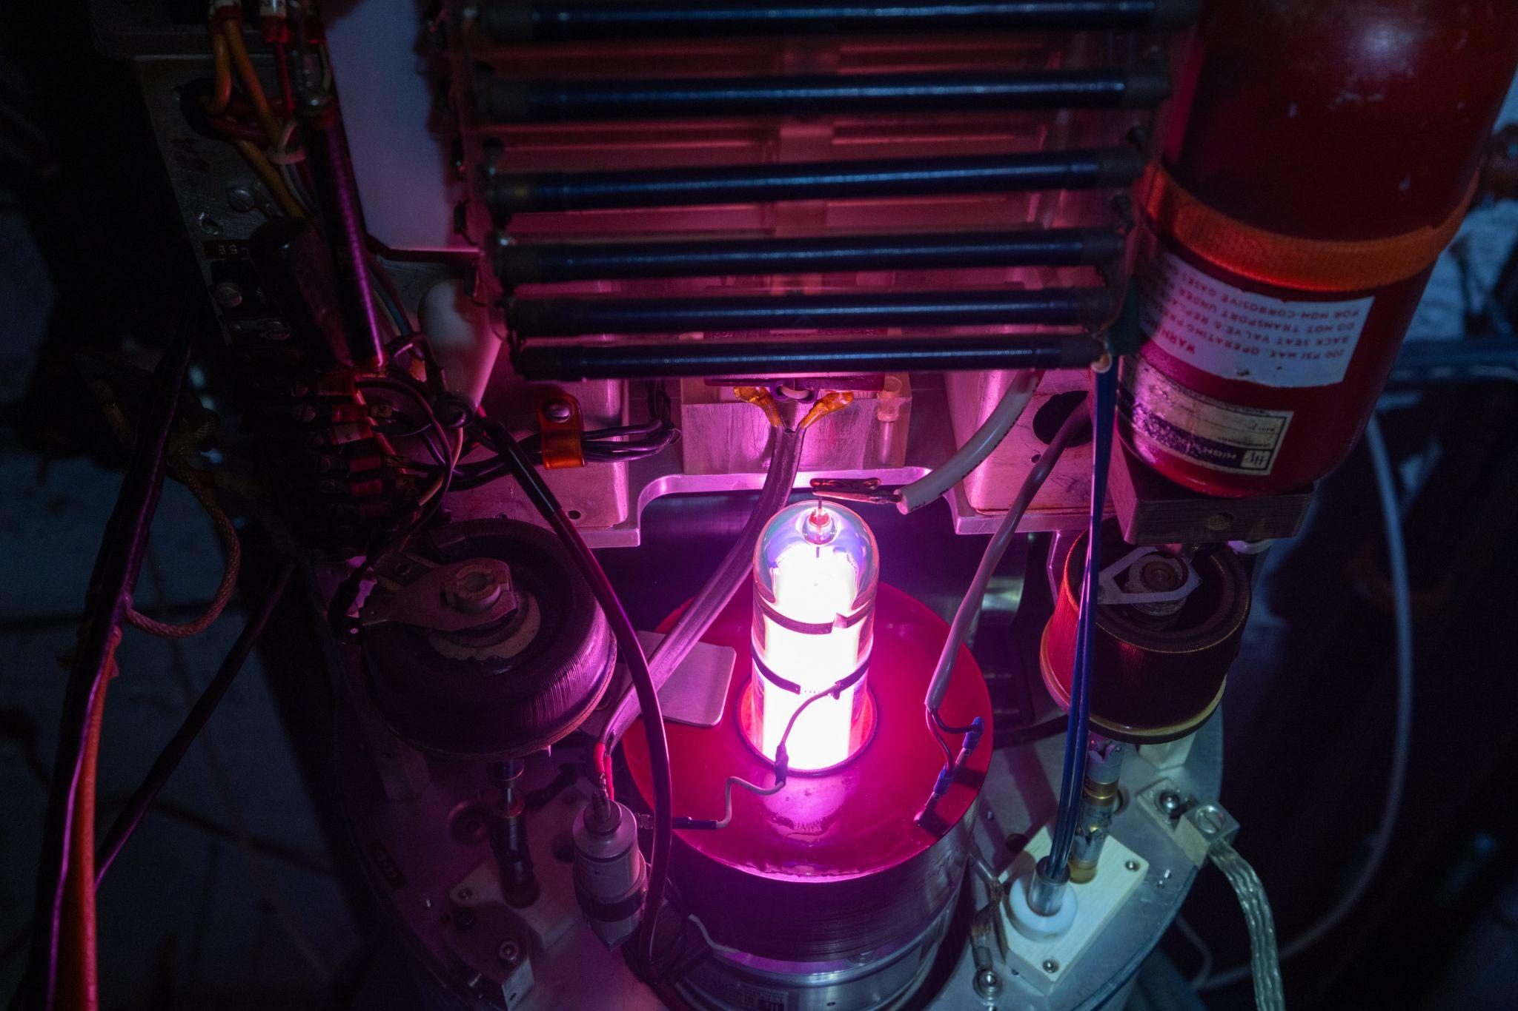
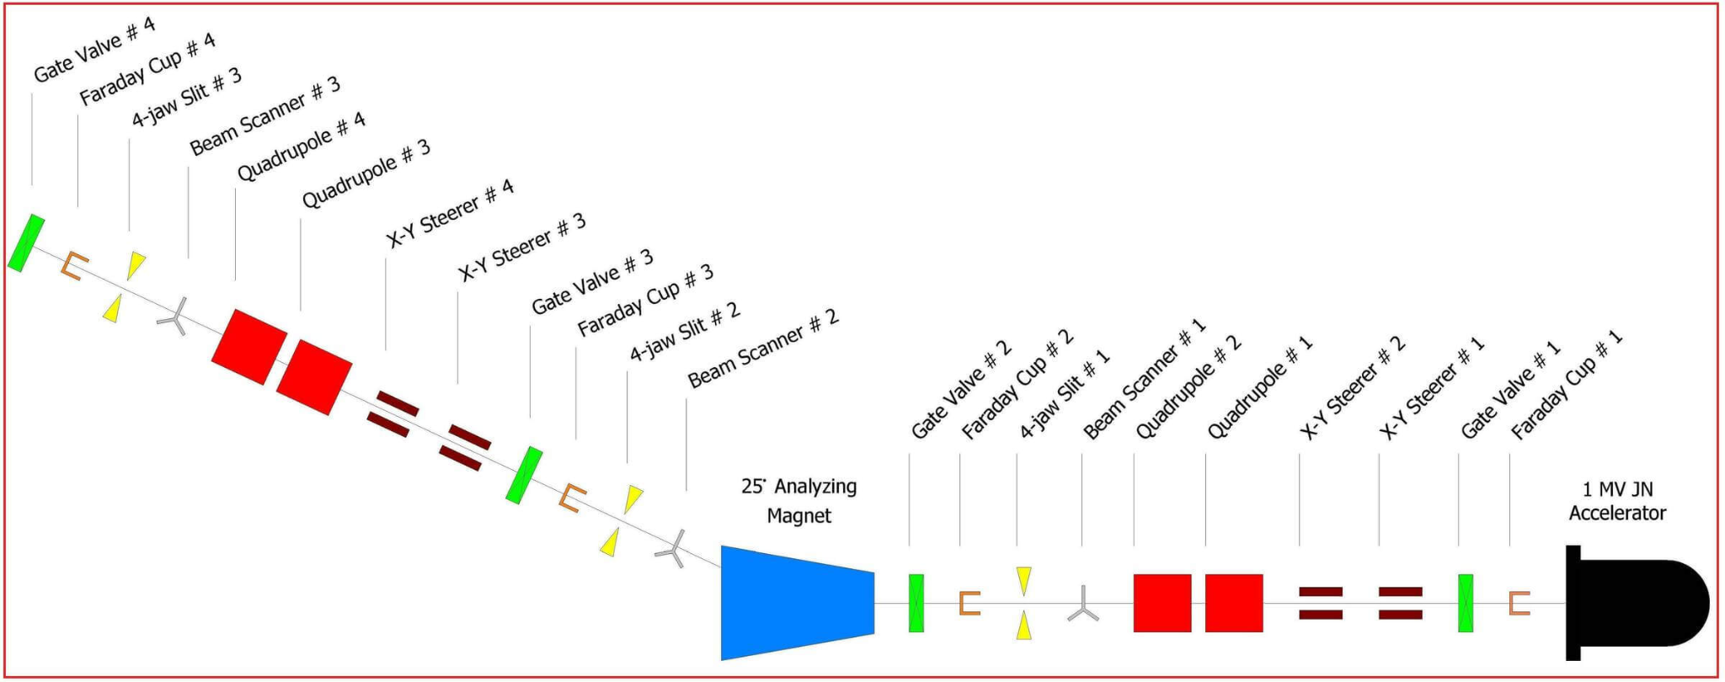
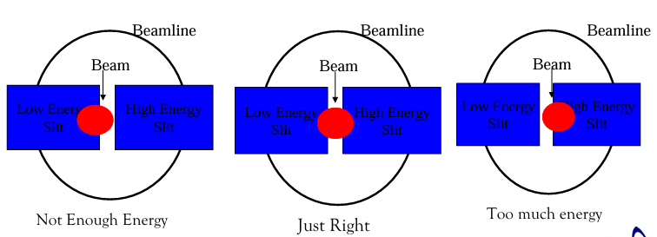
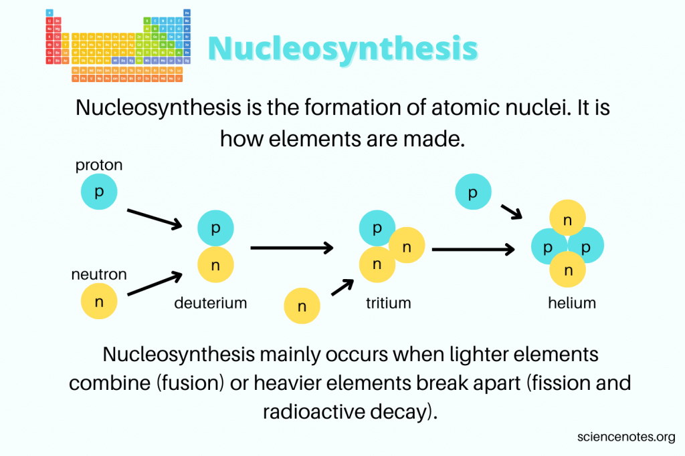
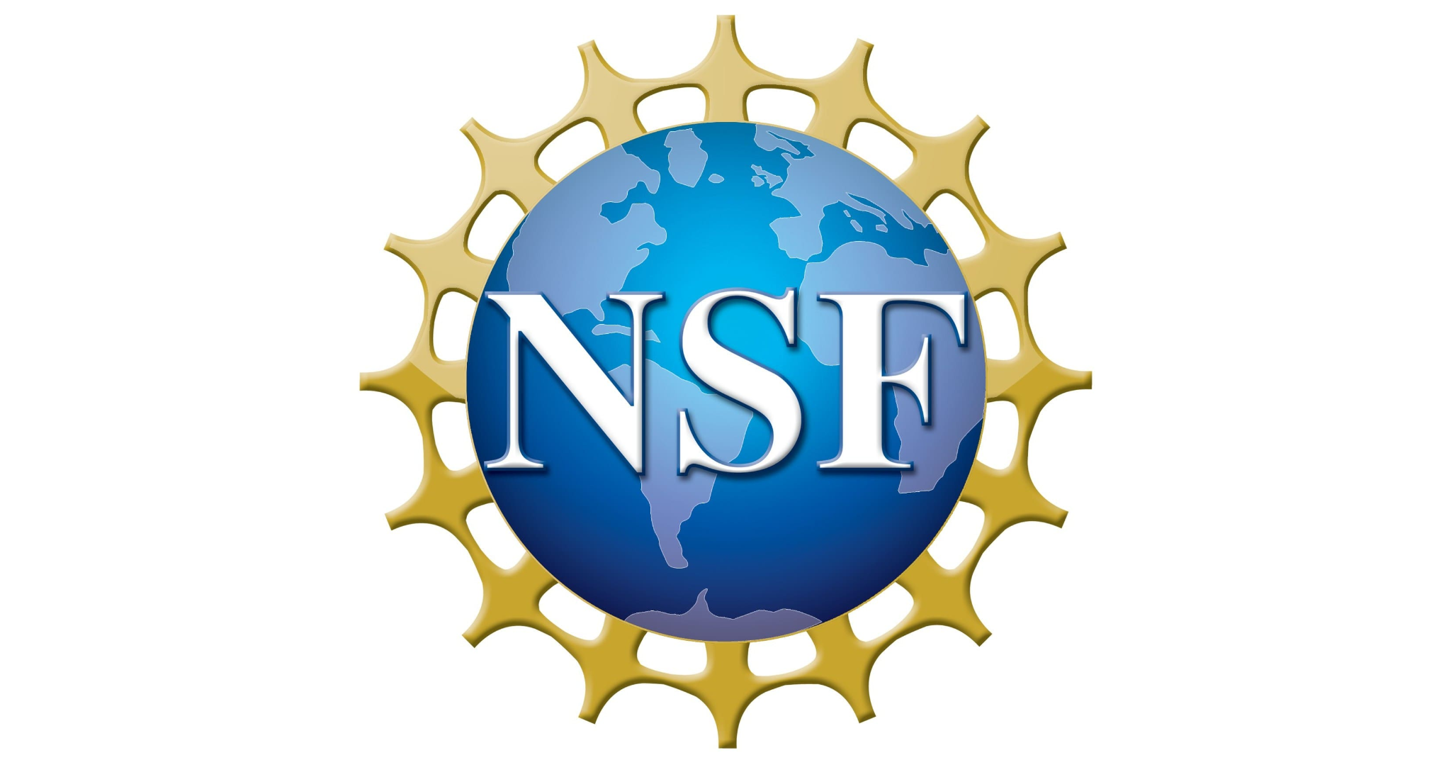



The Recommissioning of the Compact Accelerator for Performing Astrophysical Research (CASPAR)
Olivia Cantrell¹, Mark Hanhardt², Dr. Doug Tiedt², Dr. Brianna Mount^{2,3}
¹New Mexico Institute of Mining and Technology, ²Sanford Underground Research Facility, ³Black Hills State University
Introduction
What is CASPAR?
The Compact Accelerator for Performing Astrophysical Research is an accelerator laboratory focused on low-energy nuclear astrophysics. The primary goal of CASPAR is to extend our understanding of the stellar burning regime, where nuclear reactions occur at the low energies relevant to astrophysical processes. In 2021, CASPAR was disassembled and put into storage due to excavations starting nearby. With excavations completed, the accelerator is currently being recommissioned.
Experimental Set-Up
Properties and Equipment
Figure 3: Nitrogen plasma in the ion source tube
Acknowledgements
Figure 2: CASPAR Beamline Overview (2)
I gratefully thank the NSF for their support of this undergraduate research experience. Special thanks to Brianna Mount, Doug Tiedt, Mark Hanhardt, Dan Robertson, and Chad Ronish for their commendable mentorship and my fellow BHSU/SURF REU awardees for their cherished companionship.
Understanding the nature of the universe one reaction at a time
CASPAR is a 50ft long 1 MV JN accelerator that includes a 25 degree angle of deflection created by a magnet which allows particles with the correct charge-momentum ratio to deflect to the target.
Stellar Nucleosynthesis
Why is nucleosynthesis important?
Nucleosynthesis is the process that creates new atoms, more complex than the Hydrogen atom, from pre-existing nucleons. What we can learn from stellar nucleosynthesis are the nuclear reactions fueling stellar environments as well as elemental production.
References
1.Helmenstine, A. (2025, April 8). Nucleosynthesis - how elements are made. Science Notes and Projects.
2. Marketing Communications: Web | University of Notre Dame. (n.d.). Experimental set-up & equipment. CASPAR.
3. FN tandem van de graaff accelerator at Notre Dame. (n.d.).
Figure 3: Illustration of desired beam slit energy (3)
An RF ion source creates positive ions via ionized gas to produce either a proton or alpha beam. Particles that are too heavy or lack sufficient charge for the reaction continue moving in a straight line, while those that are too light or overly charged deviate by more than 25 degrees. CASPAR is also equipped with a modular target station which can be used for either gas or solid-target experiments.
Figure 1: Example of fusion pathway Nucleosynthesis (1)

