Slide 1




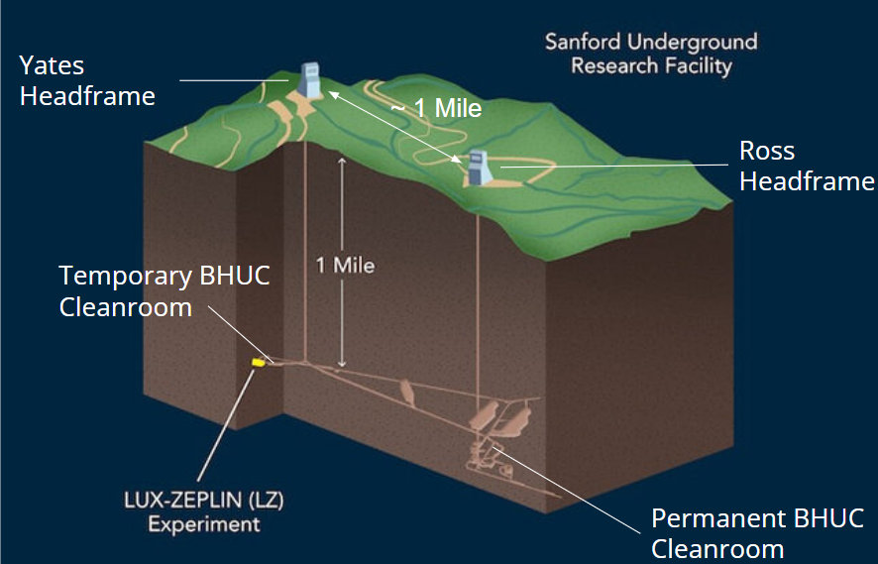
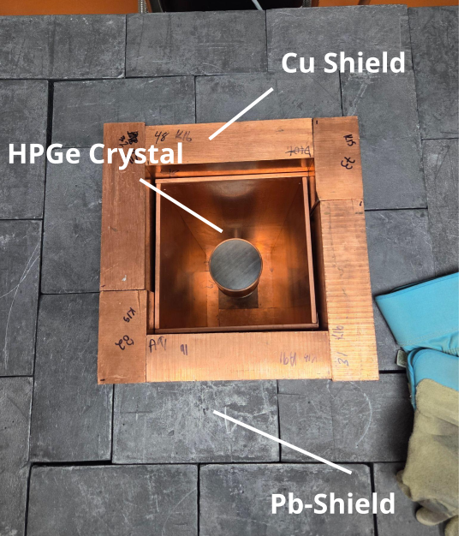
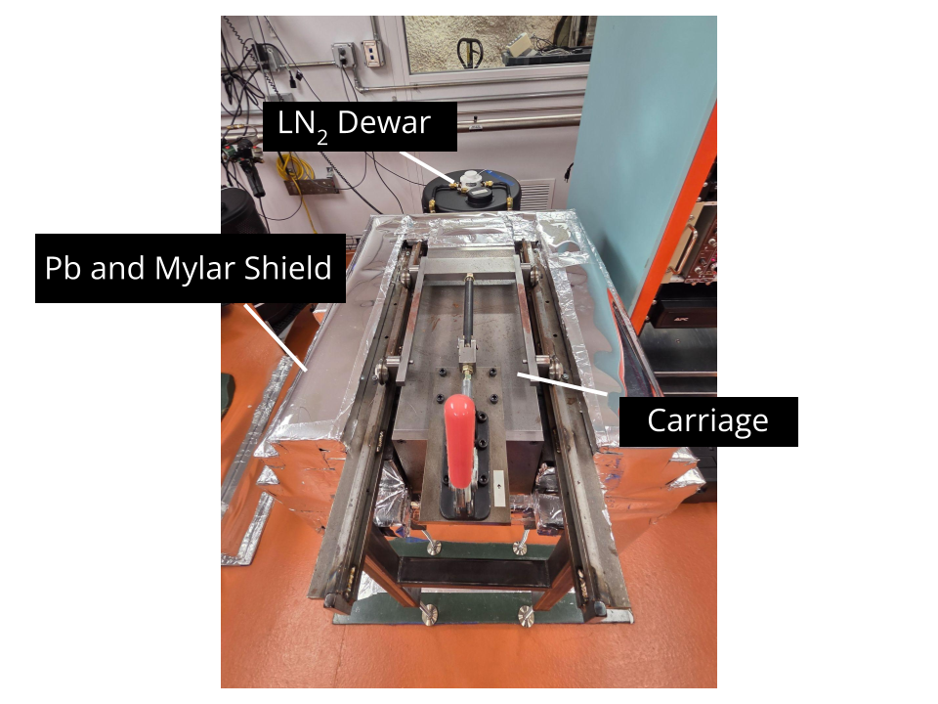
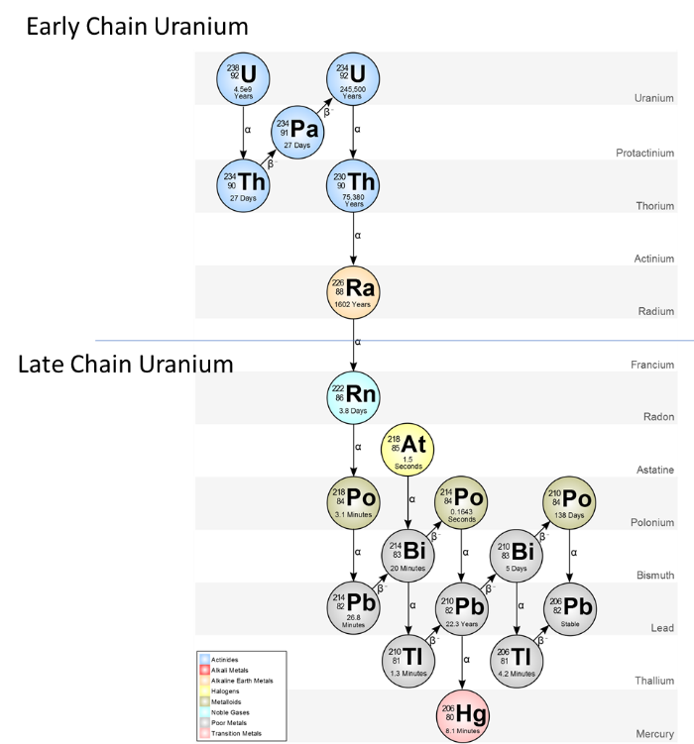
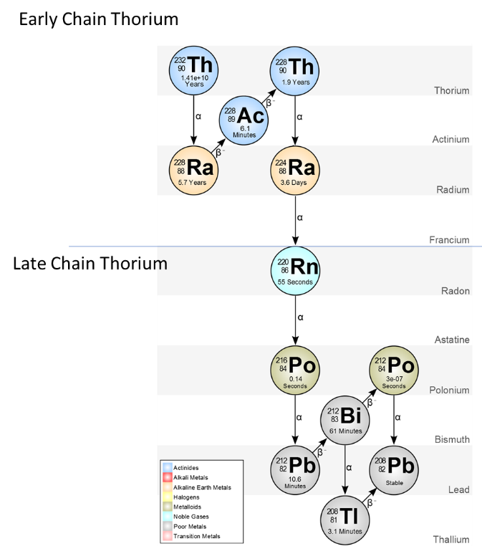
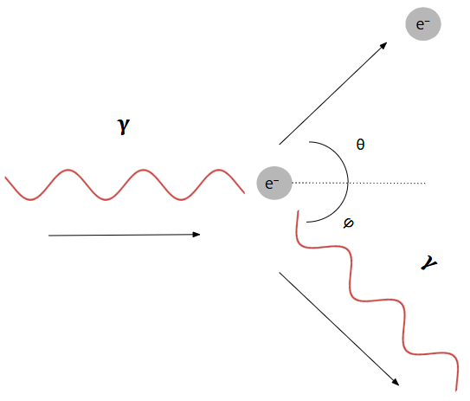
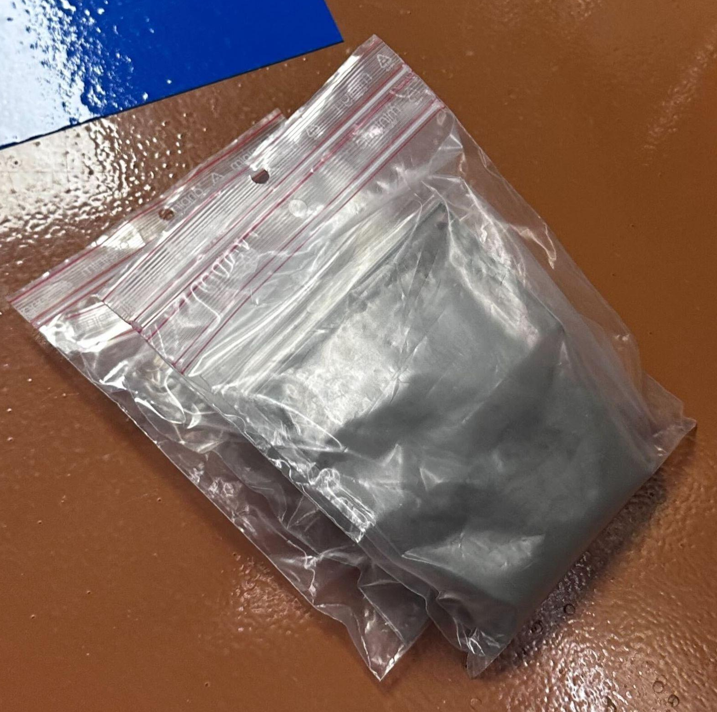
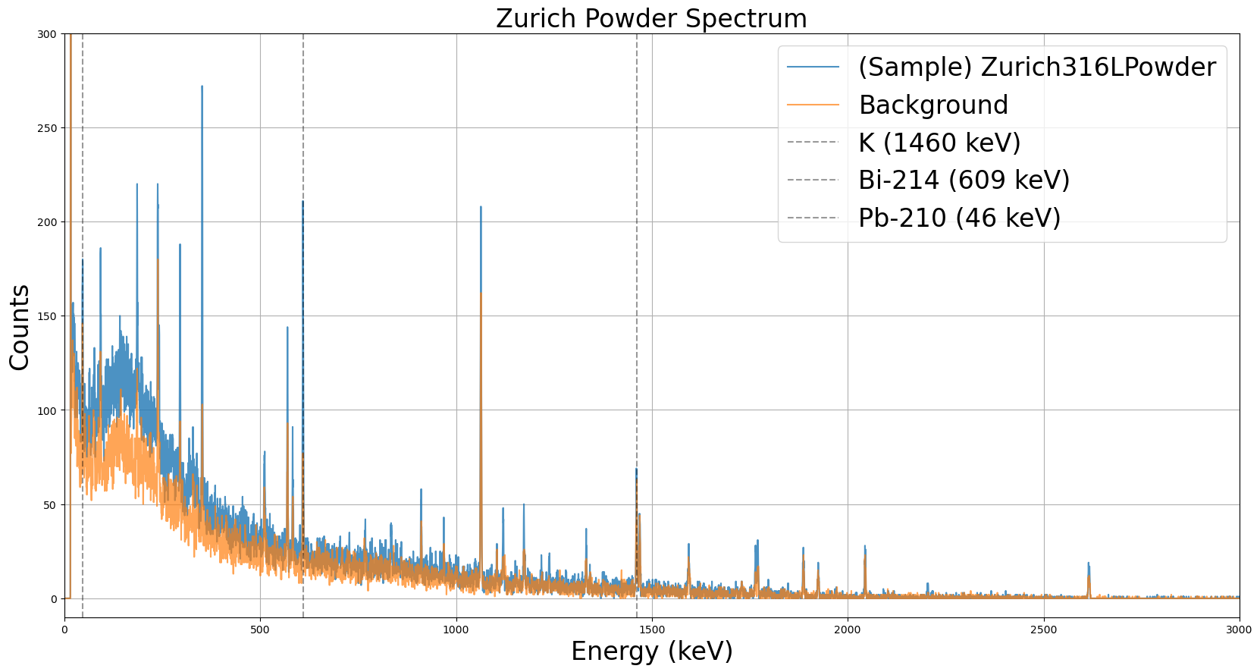
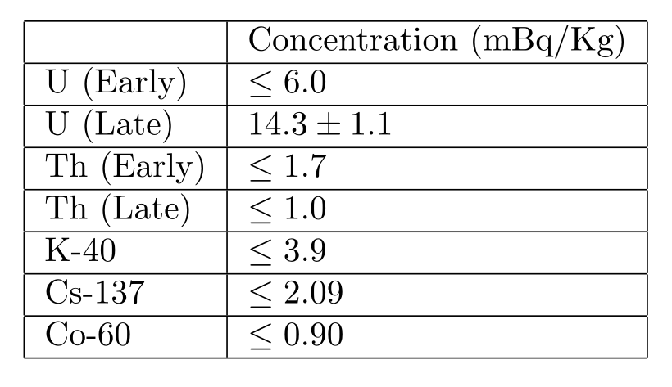
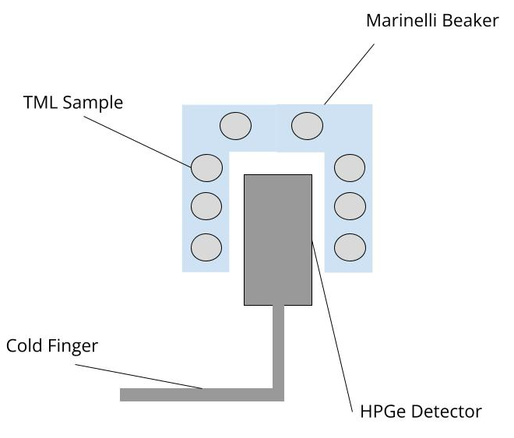
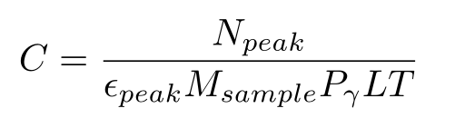
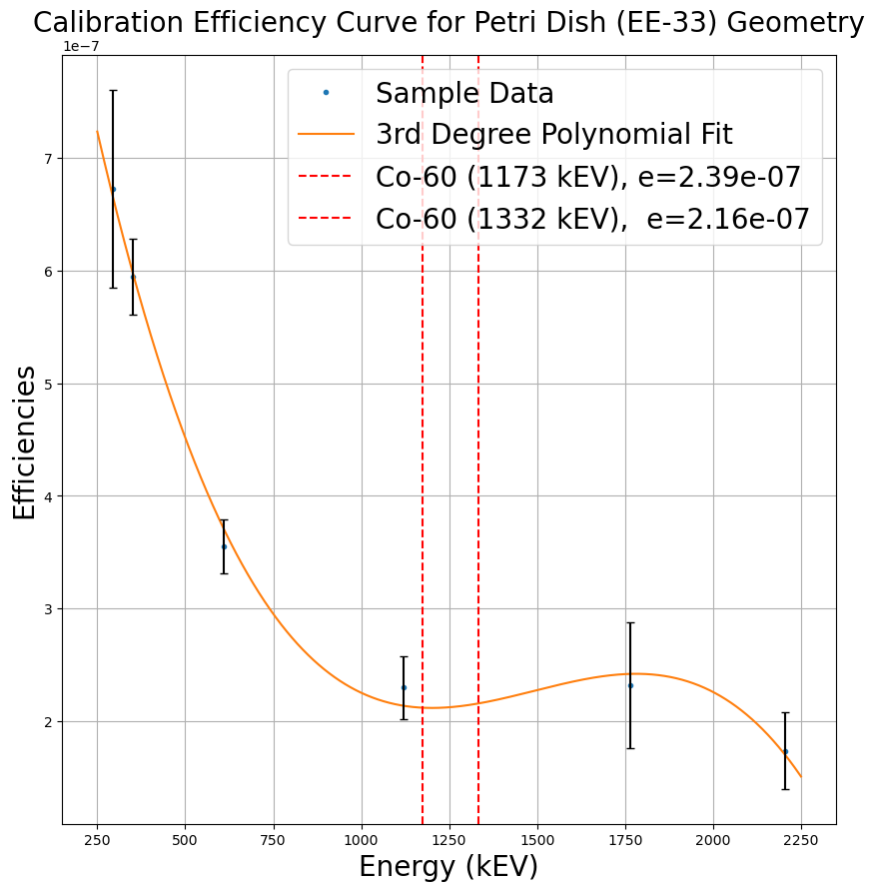
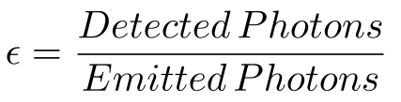
Gamma-ray Spectroscopy with High Purity Germanium Detectors
Foster Carroll¹, Nicholas Bearer² , Katie Pedneau³, and Brianna Mount³
¹ Carleton College, ² Texas A&M University Corpus Christi, ³ Black Hills State University
Introduction
Setup of the BHUC
The Black Hills Underground Campus (BHUC) is located on the 4850L of the Sanford Underground Research Facility (SURF) in Lead, SD. It currently houses 5 low background counting systems for determining the radiopurity of materials [1].
Materials used in underground physics experiments such as those studying neutrinoless double-beta decay, neutrino oscillations, and dark matter detection require low levels of radiation, high radiopurity. Materials’ radioactivity is screened using gamma-ray spectroscopy. In the BHUC, high-purity germanium (HPGe) detectors are used to measure the concentration of radioactive elements such as U, Th, and K present in a sample material [1].
These assays inform various underground physics experiments on the background of materials to be used in dark matter detectors. This is useful in experiment development to determine which materials should be used to maintain low-backgrounds and informs experiments on how background from the materials used in apparatus will influence the data [1].
In the summer of 2025, the BHUC returned from its temporary location in the Davis campus to its permanent location in the Ross campus (see Fig. 1). Each detector had to be deconstructed in the temporary BHUC cleanroom and reconstructed at the permanent BHUC.
Moving the Detectors
Pb-shields surround the HPGe detectors. Pb is commonly used in experiments to shield from radiation [6]. 2,227 of Pb bricks (~57,000 lbs) were moved for the reconstruction of the detectors. In addition to Pb, the detectors are surrounded by Mylar to prevent Rn from the environment seeping into the detector and to keep N₂ gas inside the detector, purging it of unwanted contaminants [1].
Components of the Detector
Pb-shield - Blocks radiation from outside the sample-chamber.
Copper (OFHC) - Used to absorb fluorescent x-rays from the Pb-shield. [3]
Mylar - Covers any air gaps in the Pb-Shield, helping to keep Rn out and N₂ inside of the detector.
Carriage - Filled with Pb, covers opening to the sample chamber. Is pulled out to access the crystal when loading a sample.
LN2 Dewar - Used for cooling the Ge-crystal to prevent thermal noise in the detector [Gilmore/BHUC].
Clean Room Protocols
The BHUC is a class-1000 cleanroom [1].
Nearly every material that was moved had to be wiped with Isopropyl Alcohol Wipes (IPA wipes) to maintain cleanliness of clean room. Apparatus being moved underground were wrapped in plastic wrap before movement to maintain cleanliness.
Ross Campus
Davis Campus
Fig 1. Above-ground and 4850L of the Sanford Underground Research Facility with locations of the temporary and permanent BHUC cleanrooms [2].
Background
The BHUC currently houses 5 HPGe detectors: Morgan, Maeve, Mordred, RHYM/RESN, and the Twins. Gamma-rays are emitted through the decay process of radioactive isotopes in sample materials such as U-238, Th-232, K-40, and their daughter nuclides (see Fig. 2) [3]. The result of the decay process often is an excited daughter nuclide which will give off energy as it returns to its ground state [3]. The amount of energy it was excited by is quantized and is released by means of a photon, a gamma-ray (depending on the energy), which will then interact with the Ge-crystal [3].
Fig 6. (Top) Constructing Mordred Detector. (Bottom) Finished Morgan Detector
Gamma-ray Spectroscopy
Data
Gamma rays transfer energy to the electrons in Ge atoms in the Ge crystal. Compton scattering, the photoelectric effect, and pair production are the mechanisms in which energy is transferred from the gamma-ray to the Ge crystal (see Fig 3). [3]
The scattering of electrons within the Ge crystal leads to the creation of electron-hole pairs. These electron-hole pairs are what create measurable signals in the detector. [3]
The identity of the source radioisotope is determined by the energy of the gamma-ray which corresponds to the energy measured by the detector.
The analyzed sample is 316L stainless steel powder which is used for laser metal printing (see Fig. 7). Materials such as these could have many applications to designing underground physics experiments.
From the collected spectra, net counts (sample - background) are determined for each spectral line (see Fig. 8). Eqn. 1 is then used to determine the concentration of U, Th, and K present in the sample (see Table 1 for the concentrations present in the Zurich powder spectrum).
Fig 3. Compton Scattering
Fig 2. Decay Chain for Uranium (left²) [4] and Thorium (right³) [5].
Table 1. Concentrations of Isotopes in the Zurich powder sample.
Methods
Calibration and Measurement
To calibrate the detectors, we use a sample with a known concentration of U, Th, and K, this is known as Table Mountain Latite (TML). The TML is placed into a marinelli beaker or a petri dish which is then placed over the HPGe crystal. [3]
In addition to the TML spectrum, we take a background spectrum as a control to determine how much radiation is present without a sample. Due to the typically low levels of radioactivity present in rare event search samples, spectra are collected for 1-2 weeks [6].
Fig. 7 Picture of Zurich powder sample
Fig. 8 Spectra of both the Zurich powder sample and background.
C - Concentration (ppb)
N - Counts
ϵ - efficiency
M - mass of the sample (g)
P𝛾 - Probability of Emission
LT - Live time of the sample (Min)
Conclusion & Future Work
The BHUC HPGe detectors have successfully been moved back to the Ross Campus. Background data is currently being recorded to allow a comparison of the backgrounds for each of the detectors in the current BHUC to when the detectors were in the Davis Campus. This will help identify if there are any environmental conditions that need to be considered for the continued use of the detectors in the BHUC. Software will be developed to streamline the process of determining the concentration of elements in the sample after we have determined the counts of each element in the spectrum. The BHUC will shortly resume routine sample analysis.
Analysis with Software
Fig. 4 Sample in Marinelli beaker
Eqn. 1 - Equation used to determine isotope concentration [3].
Acknowledgements
Many ꞵ-decays in the U-238, Th-232, and K-40 decay chains result in a gamma-ray with a quantized amount of energy being released. The amount of gamma-rays detected are measured in counts [3].
To determine the concentration of an isotope present in a sample, the counts in a certain energy range must be calculated. This is done by taking the area under the curve of a spectrum. A program called PeakEasy [7] is used to identify lines in a spectrum and determine the total counts associated with each isotope’s decay (N_{peak}) in Eqn.1. N_{peak} is then divided by the efficiency, ϵ (see Eqn.2), the mass of the sample, M, the probability of a gamma-ray being emitted, P𝛾, and the live time of the sample in minutes LT [3].
An efficiency curve can be fit by using spectral lines with known efficiencies to determine the efficiency of another spectral line with an unknown efficiency (Fig.5) [3]. Efficiency is defined by Eqn.2 as being the number of photons of a specific spectral line being detected (Detected Photons) divided by the number of photons actually emitted by the decay (Emitted Photons) [3].
This project was funded by NSF Award 2150517. We thank the National Science Foundation for funding research experiences for undergraduate students such as this project. We also thank Olivia Cantrell, Dylan Chase, Isabella Lopez, Zachary Spangler, and Doug Tiedt for their help moving the HPGe detectors and the Pb-shielding. We would also like to thank Jay Hockhalter and Robyn Varland for ensuring we had the proper PPE underground and giving us rides between the Yates and Ross shafts.
References
Mount, B., Applied Radiation and Isotopes (2017), dx.doi.org/10.1016/j.apradiso.2017.02.025. Accessed 23 Jul. 2025.
Dark Matter Detection Receives 10-Ton Upgrade | College of Letters & Science, University of Wisconsin-Madison. ls.wisc.edu/news/dark-matter-detection-receives-10-ton-upgrade. Accessed 21 Jul. 2025.
Gilmore, Gordon. Practical Gamma-ray Spectrometry. Second Edition. John Wiley & Sons, Ltd., 2008.
Uranium-235 and Uranium-238 | Hazardous Waste Cleanup Levels | Washington University in St. Louis. sites.wustl.edu/hazardouswaste/radionuclides/uranium/. Accessed 21 Jul. 2025.
Thorium-230 and Thorium-232 | Hazardous Waste Cleanup Levels | Washington University in St. Louis. sites.wustl.edu/hazardouswaste/radionuclides/thorium/. Accessed 21 Jul. 2025.
Akerib, D. S., et al. “The LUX-ZEPLIN (LZ) Radioactivity and Cleanliness Control Programs.” The European Physical Journal C, vol. 80, no. 11, Nov. 2020. arXiv.org, doi.org/10.1140/epjc/s10052-020-8420-x. Accessed 23 Jul. 2025.
PeakEasy. peakeasy.lanl.gov/. Accessed 23 Jul. 2025.
Baxter, D., et al. [2203.07623] Snowmass2021 Cosmic Frontier White Paper: Calibrations and Backgrounds for Dark Matter Direct Detection. arxiv.org/abs/2203.07623. Accessed 23 Jul. 2025.
Eqn. 2 - Efficiency Equation, used to determine the unique efficiency for each detector, spectrum, and sample geometry [3].
Fig. 5 Efficiency Curve used to determine efficiency of Co-60
Notes:
:laser metal printing. It is 316L stainless steel powder, a fine, micron-scale powder.

