Slide 1



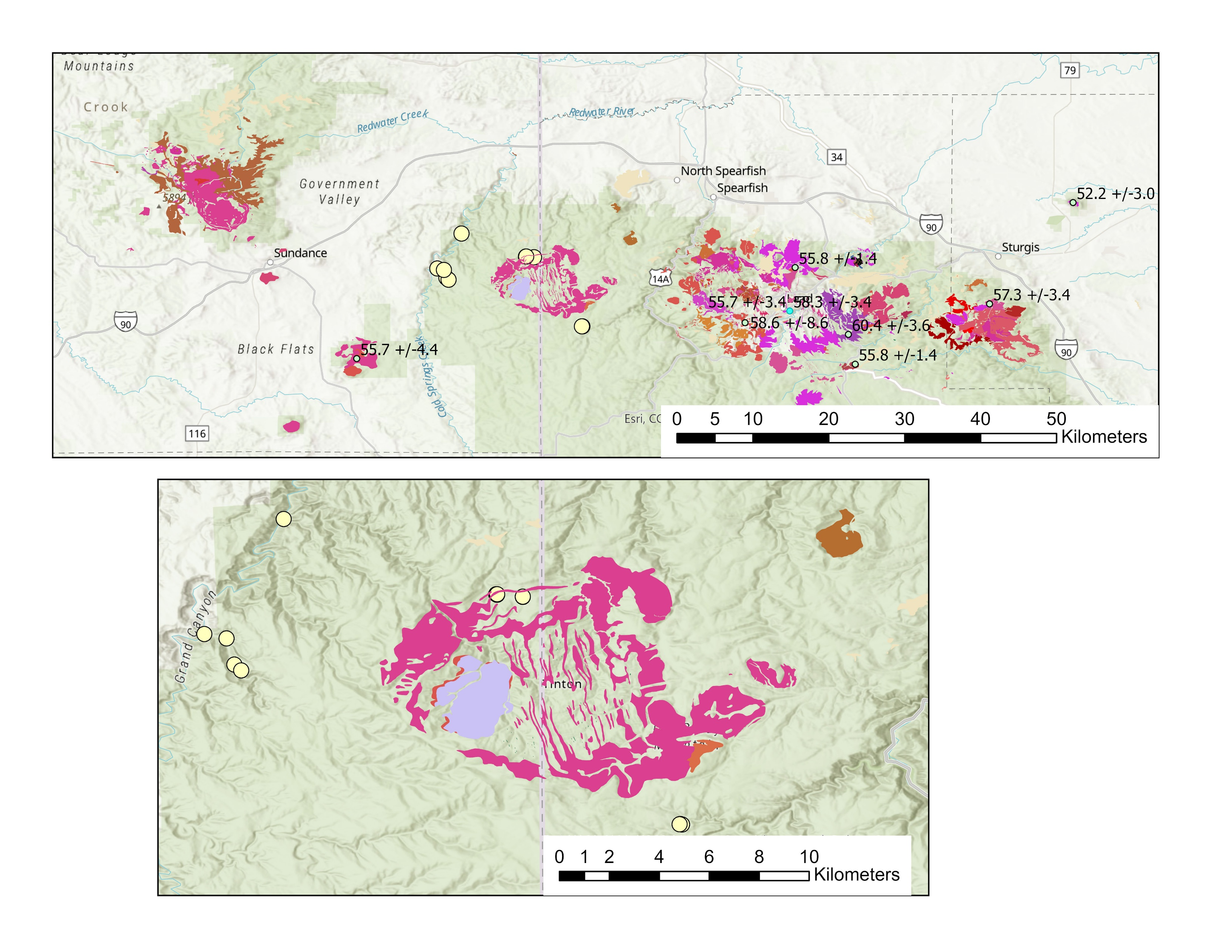
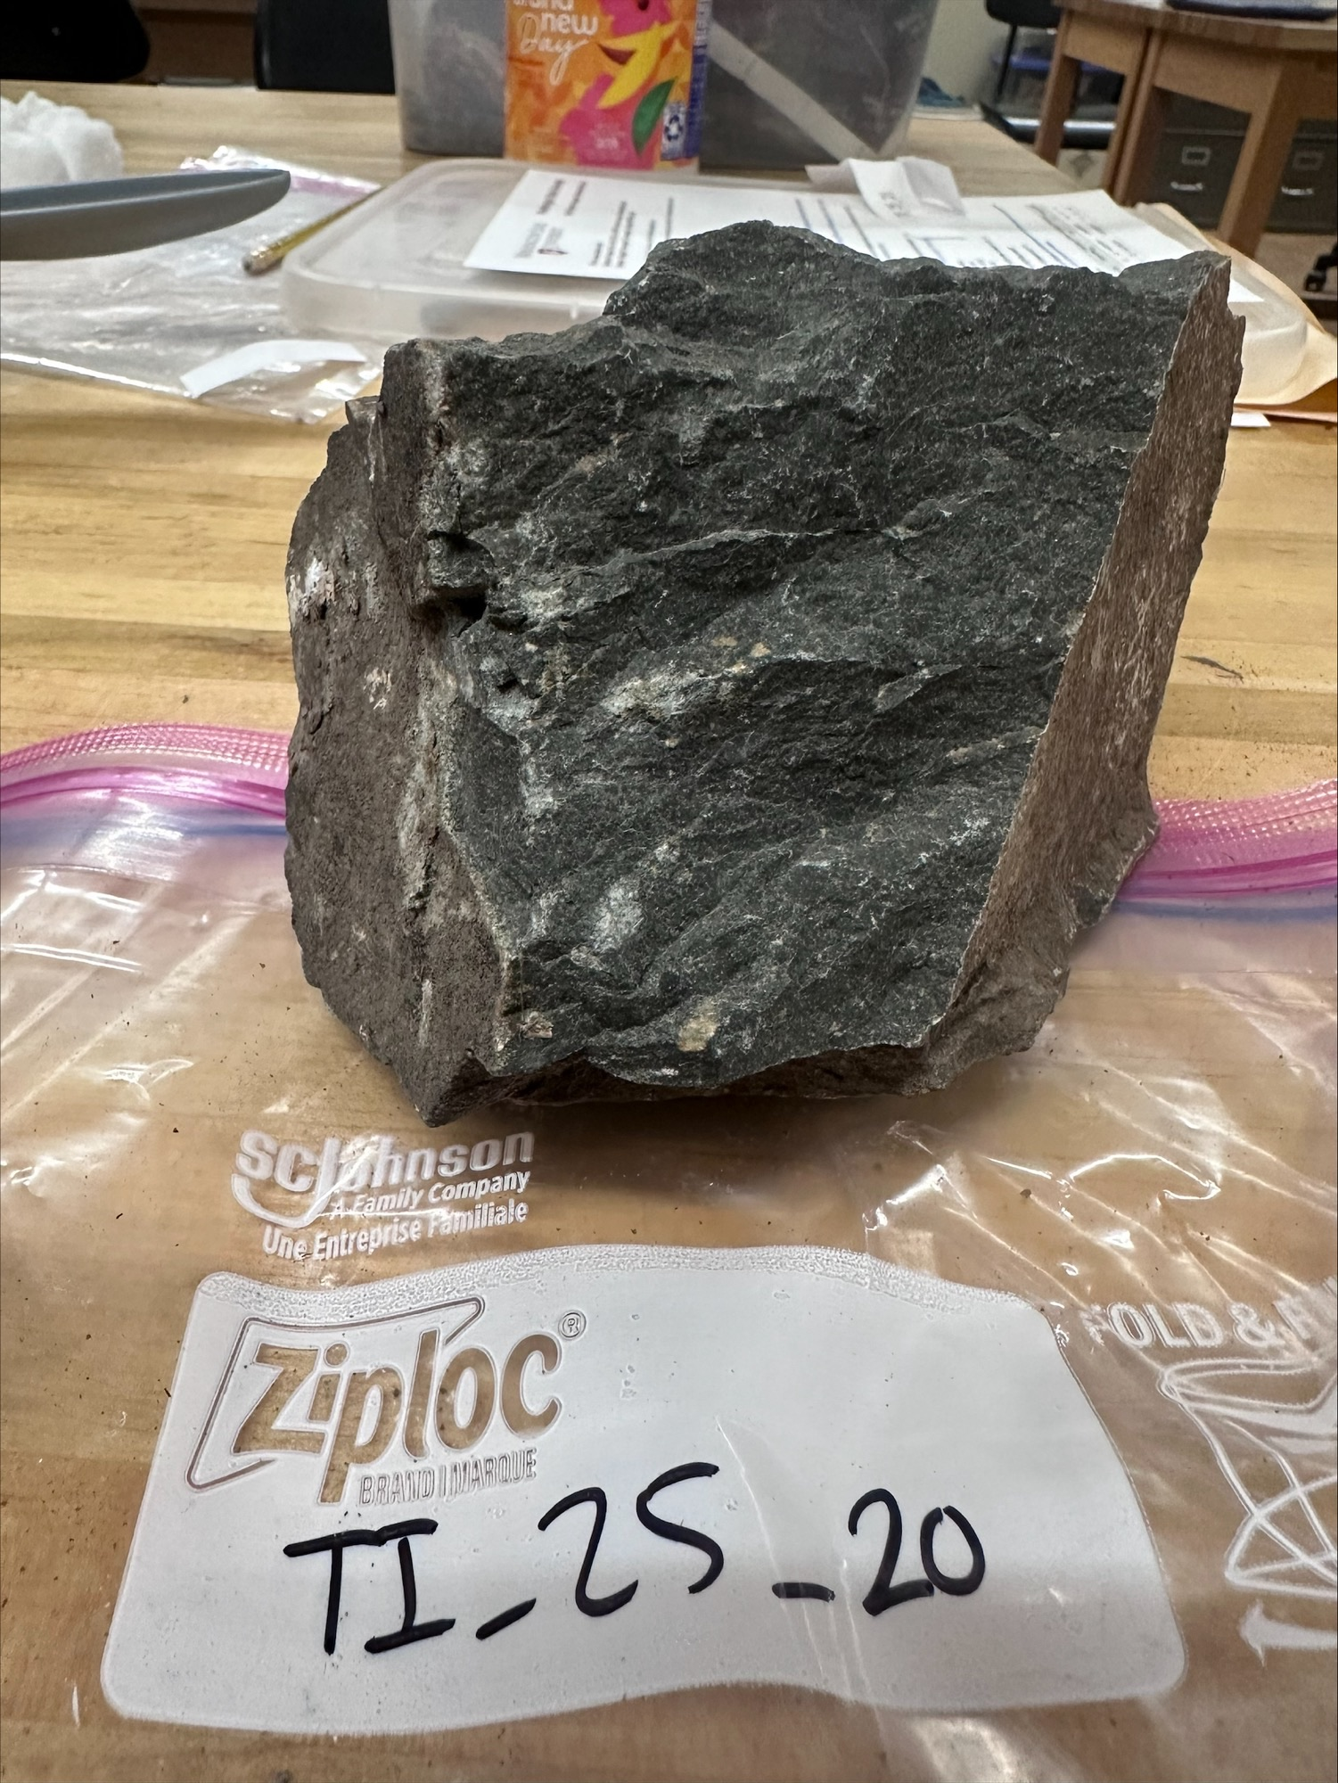
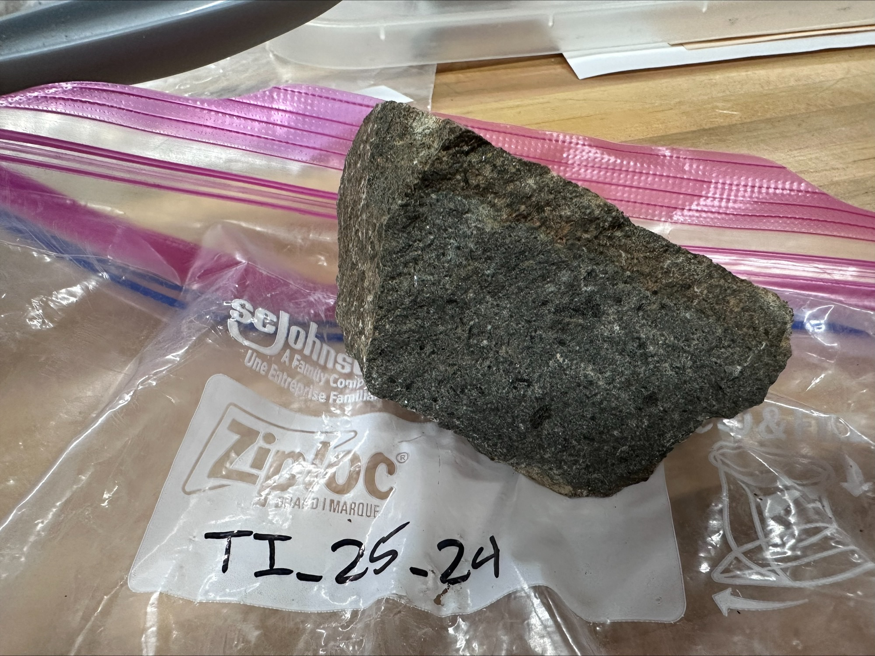
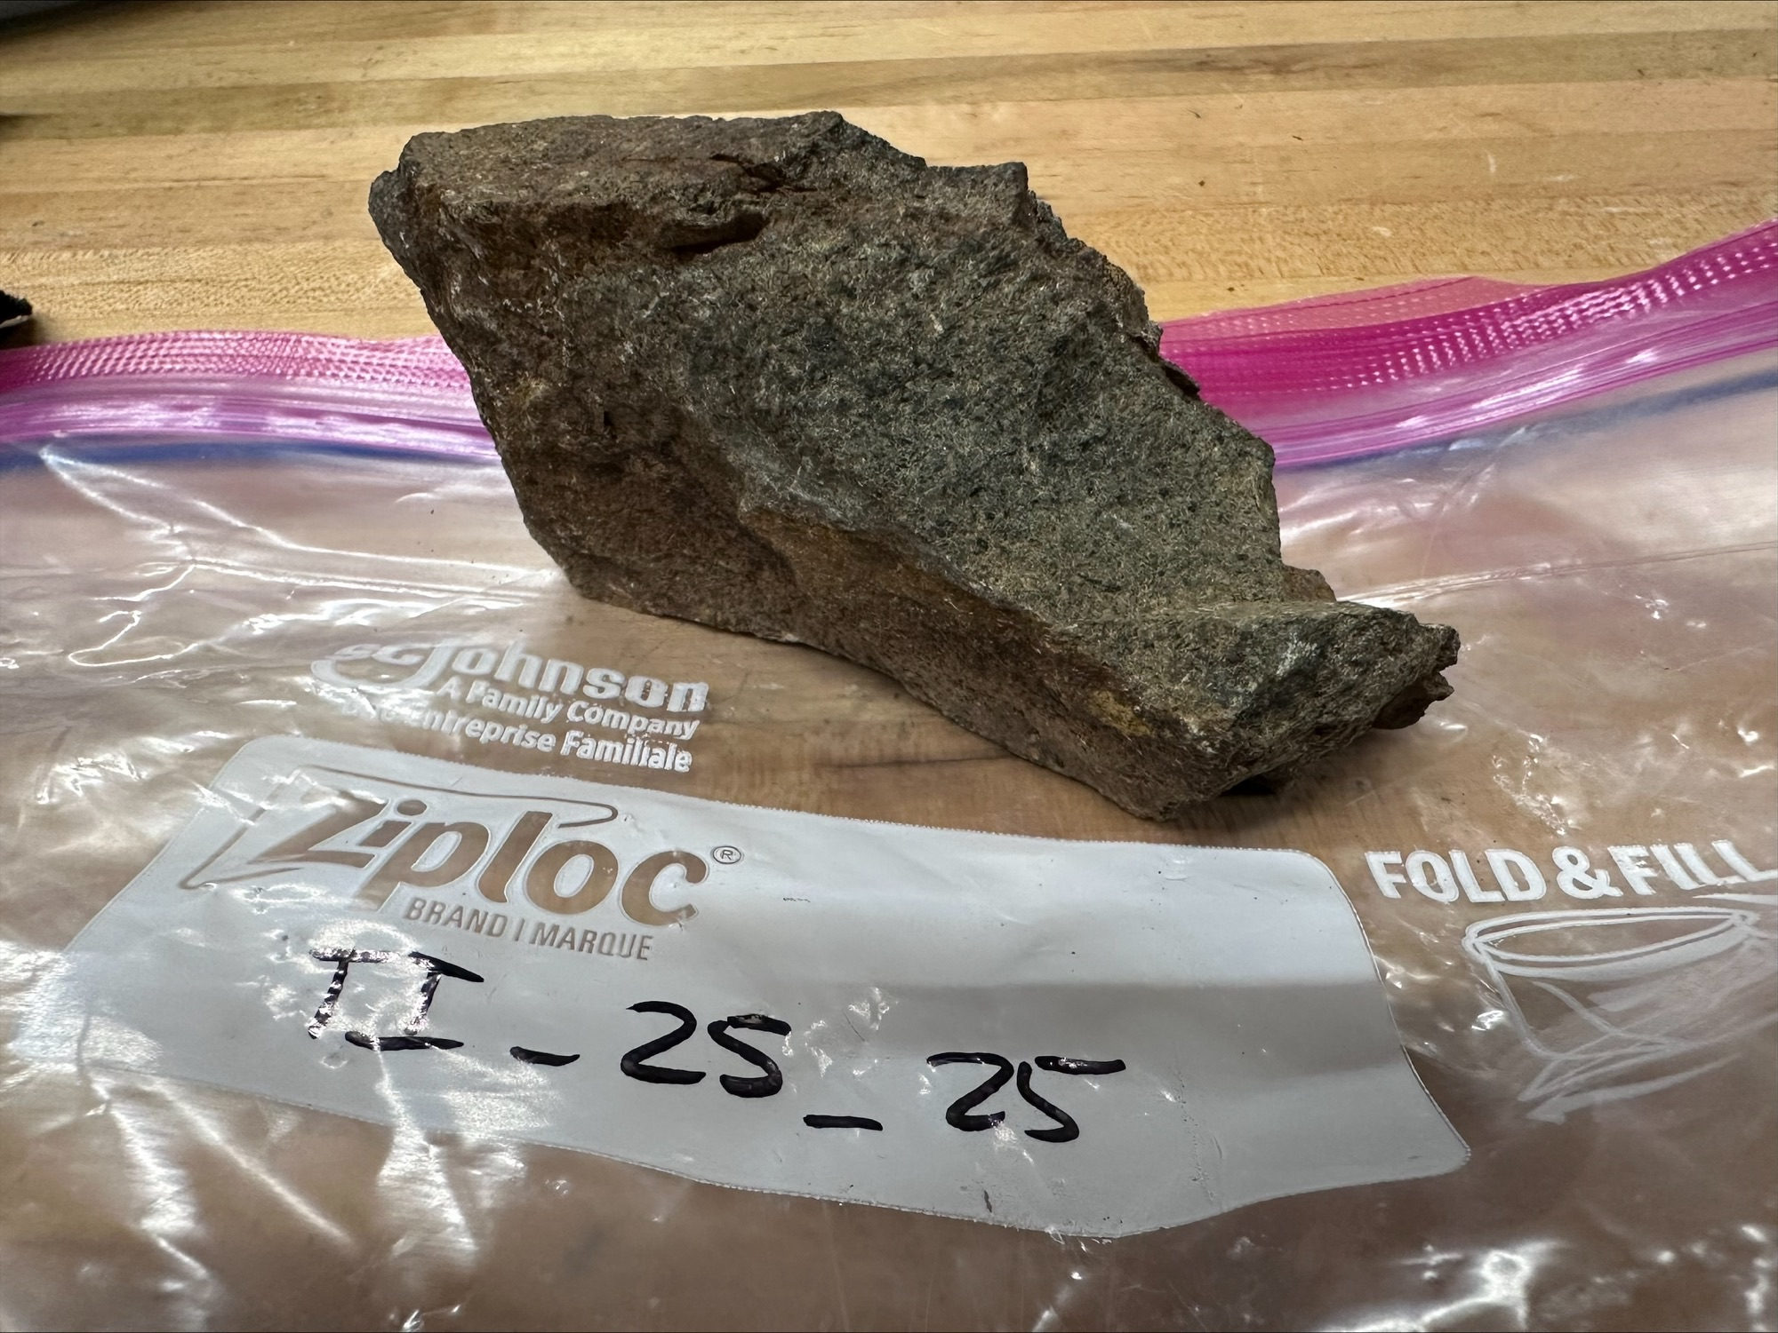
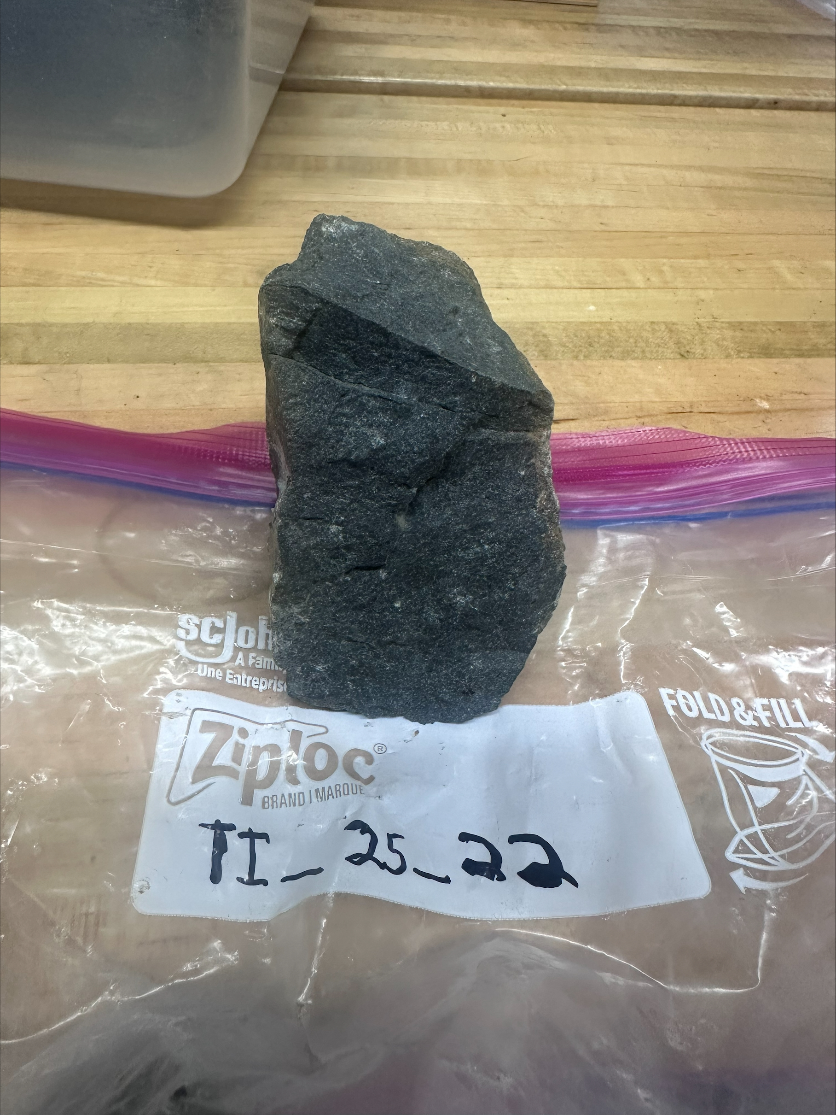
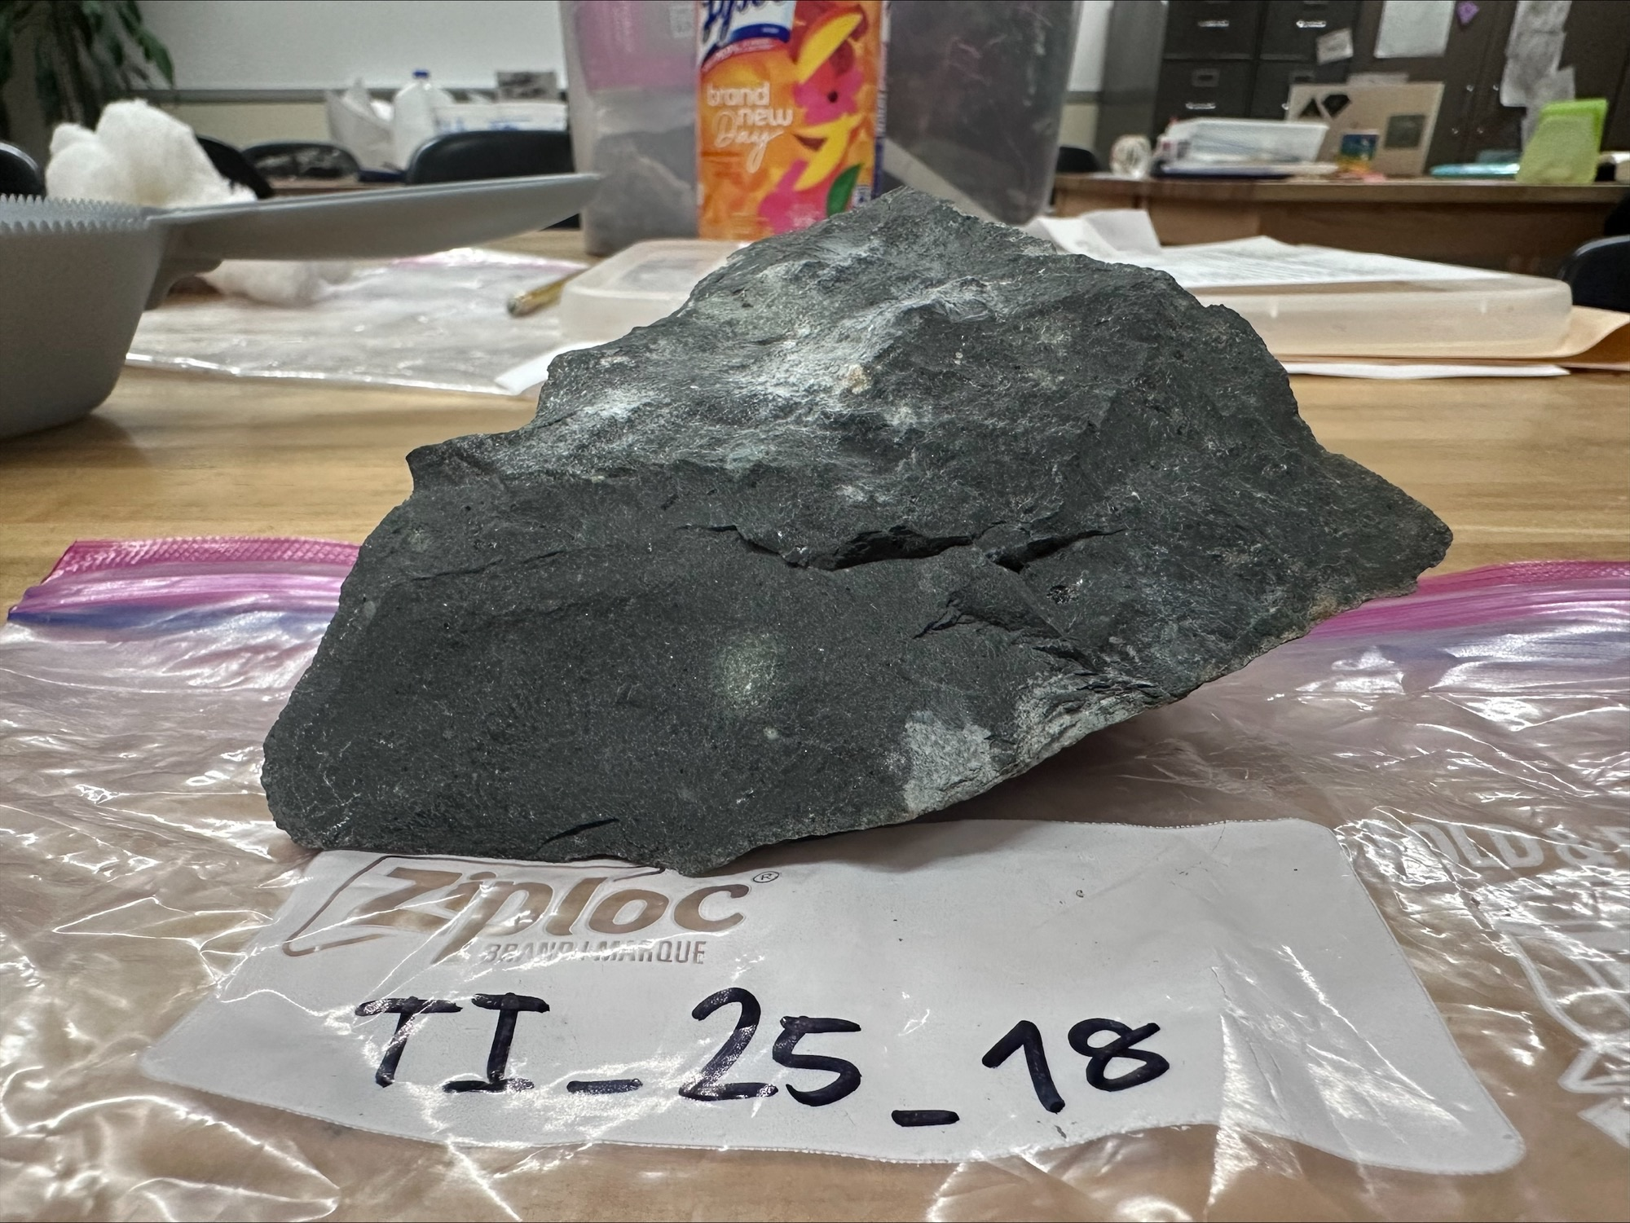
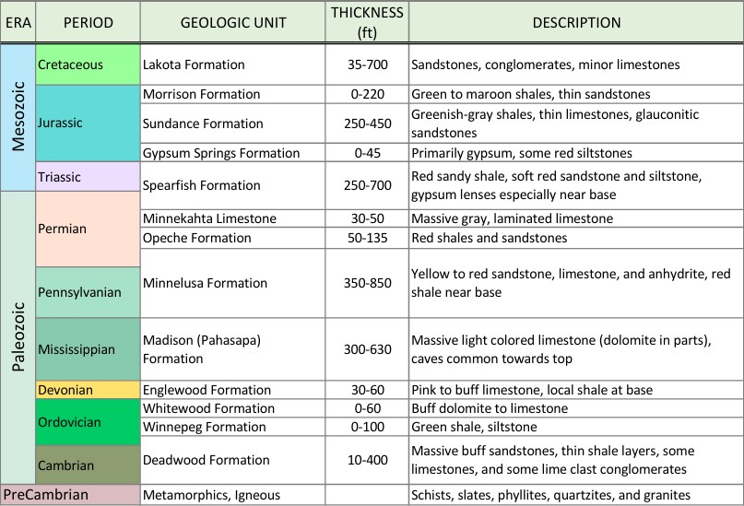
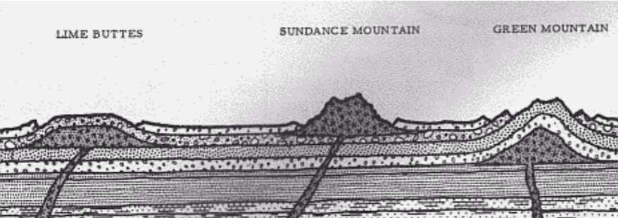
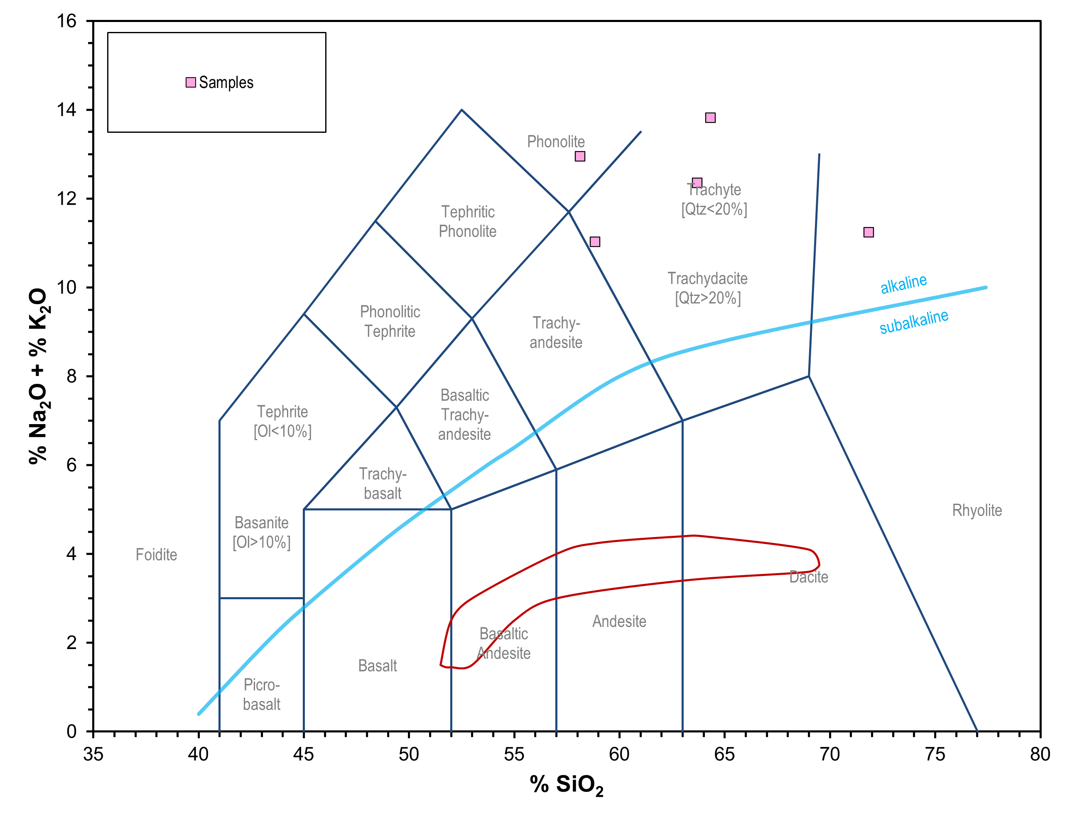
Introduction:
A 60+ mile, N70W trend of thousands of magmatic igneous intrusions run across the Northern Black Hills of South Dakota lay thousands of magmatic igneous intrusions.
Due to gold remineralization related to these intrusions many of the larger intrusions have been mapped and documented.
  We have located at least 3 unmapped intrusions and hypothesize that there many more small intrusions that exist unmapped.
We know where and when these intrusions surfaced but as to how they arose remains unknown.
  Researching these tertiary intrusions will yield many benefits towards our understanding of the Black Hills and how it formed.
The two main goals of this research project are to:
  Collect and compile all data regarding tertiary intrusions into one location (GIS).
  Collect rock samples for geochemistry and petrology of the unmapped units and compare them with previously recorded units.
..
Data Collection & Methodology:
The initial goal for this project was to catalog any intrusions that had not yet been mapped within the Northern hills.
  The focus of the research transitioned into looking for unmapped intrusions in the Tinton area.
The methodology used for going into the field was collecting:
  Samples large enough to gather hand sample descriptions.
  Samples small enough for petrographic thin sections.
  Samples structurally suitable enough for geochemistry analysis.
Petrographic thin sections are 30 nm-think slices of rock and the purpose of acquiring them is to:
  Reveal more accurate mineralogy.
  Give information as to what is happening within magma chambers at depth.
  Identify mineral components in our samples.
Attaining the geochemistry of samples will give us:
  A clearer classification for each rock.
  Help us understand what is going on in magma chambers at depth.
Tertiary Intrusions Within the Northern Black Hills
Dylan Chase 1¹, Abigail Domagall 1¹
¹School of Natural Science, Black Hills State University, 1200 University Street, Unit 9008, Spearfish, SD 57799-9008
Sanford Underground Research Facility, 160 W Main St, Lead, SD 57754
²
Map
Geologic Background:
The present dome structure of the Black Hills are a result of a mountain building event known as the Laramide Orogeny.
  Between 35 million and 80 million years ago (Gries, 2003).
  Collision between the Kula and Farallon oceanic plates subducting underneath the North American continental plate (Duke, 2005).
Prior to the Laramide Orogeny, the Black Hills area consisted of flat laying sedimentary units on top of crystalline basement rock (refer to Fig. 1 for stratigraphy of the older units).
  During and after the Laramide Orogeny, intrusions were rising from magma chambers at depth and were uplifting the northern hills (Gries 2003).
Magma intruded the rock above in the form of sills, dikes, stocks, laccoliths, and some may have erupted at the surface as diatremes (see Fig. 4).
Since the end of the Laramide Orogeny, much of the overlying sedimentary units have eroded away, revealing much of the igneous and metamorphic rock seen today (Gries, 2003).
  Igneous rocks are usually more resistant to weathering and heavily influence the topography in the northern hills
Past geologic work conducted by various entities has been highly beneficial towards this research.
  Much Data remains in older theses and papers.
  Compiling these data sets into one location will greatly help future research within the northern hills.
Discussion:
This project is in its early days and will be an ongoing effort into the fall with the return of petrographic thin sections and geochemistry.
Non-mapped units add extra complexity and information to models of the Tinton area.
  Units are especially complex if they appear different from what was previously mapped.
The intrusions we have mapped appear to be a later stage event.
  less silica-rich magma surrounding the Tinton area.
Figure 2 (above): Shows a broader scale of each of the Igneous units throughout the northern Black Hills. This Figure includes the ages of each unit and shows an evolutionary trend of the Intrusions as they were rising from their respective magma chambers.
Conclusion:
A wide array of information regarding tertiary intrusions within the northern Black Hills exists but a great portion of it is not easily accessible.
There have been great efforts in understanding the tertiary intrusions for the purpose of gold mining and mineral exploration however, there has been much less focus on using the units to broaden our understanding of large-scale tectonics that brought about the intrusions.
Gathering and compiling all previously mapped units along with their associated geochemistry into one GIS file will:
  largely benefit and improve geologist’s comprehension of the complexity within the various units.
  Shed light as to what caused the igneous intrusions.
  Will be useful for future researchers to work with.
Figure 3 (left): Shows a close-up view of the Tinton area along with every location we collected an igneous intrusion sample. This figure also illustrates the physical hand samples collected and ties them to the location they were discovered. While nearly all previously mapped data of the Tinton area suggests these intrusions are of Trachytic origin, the samples collected appear to be aphanitic, more dense, more mafic, and contained fewer feldspars. This leads to the hypothesis that the samples collected in the Tinton area are more lamprophyre and pyroxenitic like.
Acknowledgments:
I would like to personally thank the NSF for funding this research, Professor Jill Schilling for her time spent accompanying us in the field, Karl Emanuel for his GIS Data, Dr. Brianna Mount and SURF for making this REU possible, and all my fellow REU interns for their companionship and the lifelong memories we’ve gotten to share.
Total Alkali vs. Silica (TAS) Diagram
Figure 5 (right): Shows a volcanic TAS diagram. Previously mapped records state that the intrusions around the Tinton area are primarily of Trachytic origin, with some amounts of Phonolite (Duke, 2005).
References Cited:
DeWitt, E., Redden, J. A., Buscher, D., and Wilson, A. B., 1989, Geologic Map of the Black Hills Area, South Dakota and Wyoming: U. S. Geological Survey Miscellaneous Investigations Series Map 1-1910, scale 1:250,000, 1 sheet
Duke, G. I., 2005, Geochemistry and Geochronology of Paleocene-Eocene Alkalic Igneous Rocks, Northern Black Hills, South Dakota and Wyoming [Ph.D. dissertation], Rapid City, South Dakota School of Mines and Technology, 292p
Gries, J.P., 2003, Roadside Geology of South Dakota: Missoula, Montana, Mountain Press Publishing Company, 358p
Paterson, C.J., Kirchner, J,G., 1996, Guidebook to the Geology of the Black Hills, South Dakota, Rapid City, South Dakota School of Mines and Technology, 230p
Figure 4 (above): Shows a diagram of the northwestern Black Hills. Specifically showing dikes moving upwards from batholiths into laccoliths. This diagram gives a representation of how igneous intrusions influence topography and elevation.
Figure 1: Shows a stratigraphic column of the Black Hills starting at the Precambrian period and ending at the Cretaceous period. Much of the younger rock in the northern Black Hills has eroded away, revealing rocks as old as the Deadwood formation and many of the younger igneous intrusions that cross-cut them.

