Slide 1




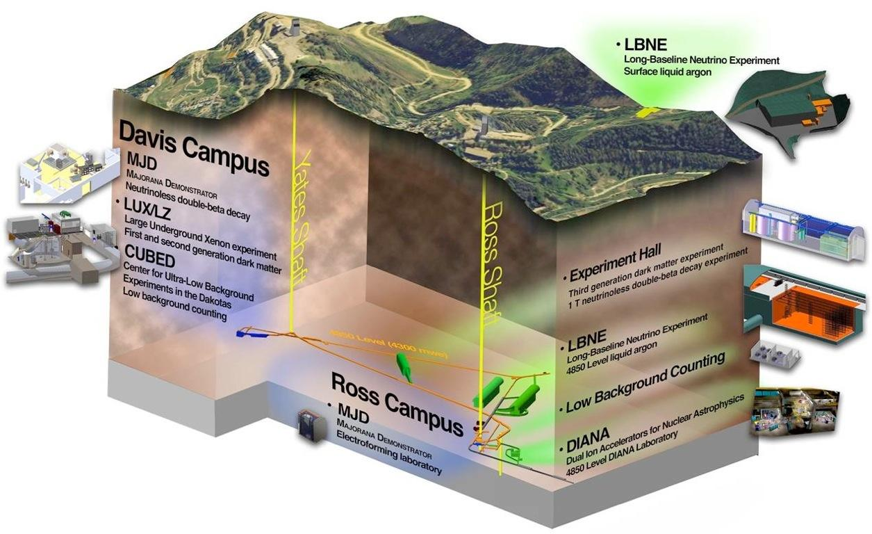
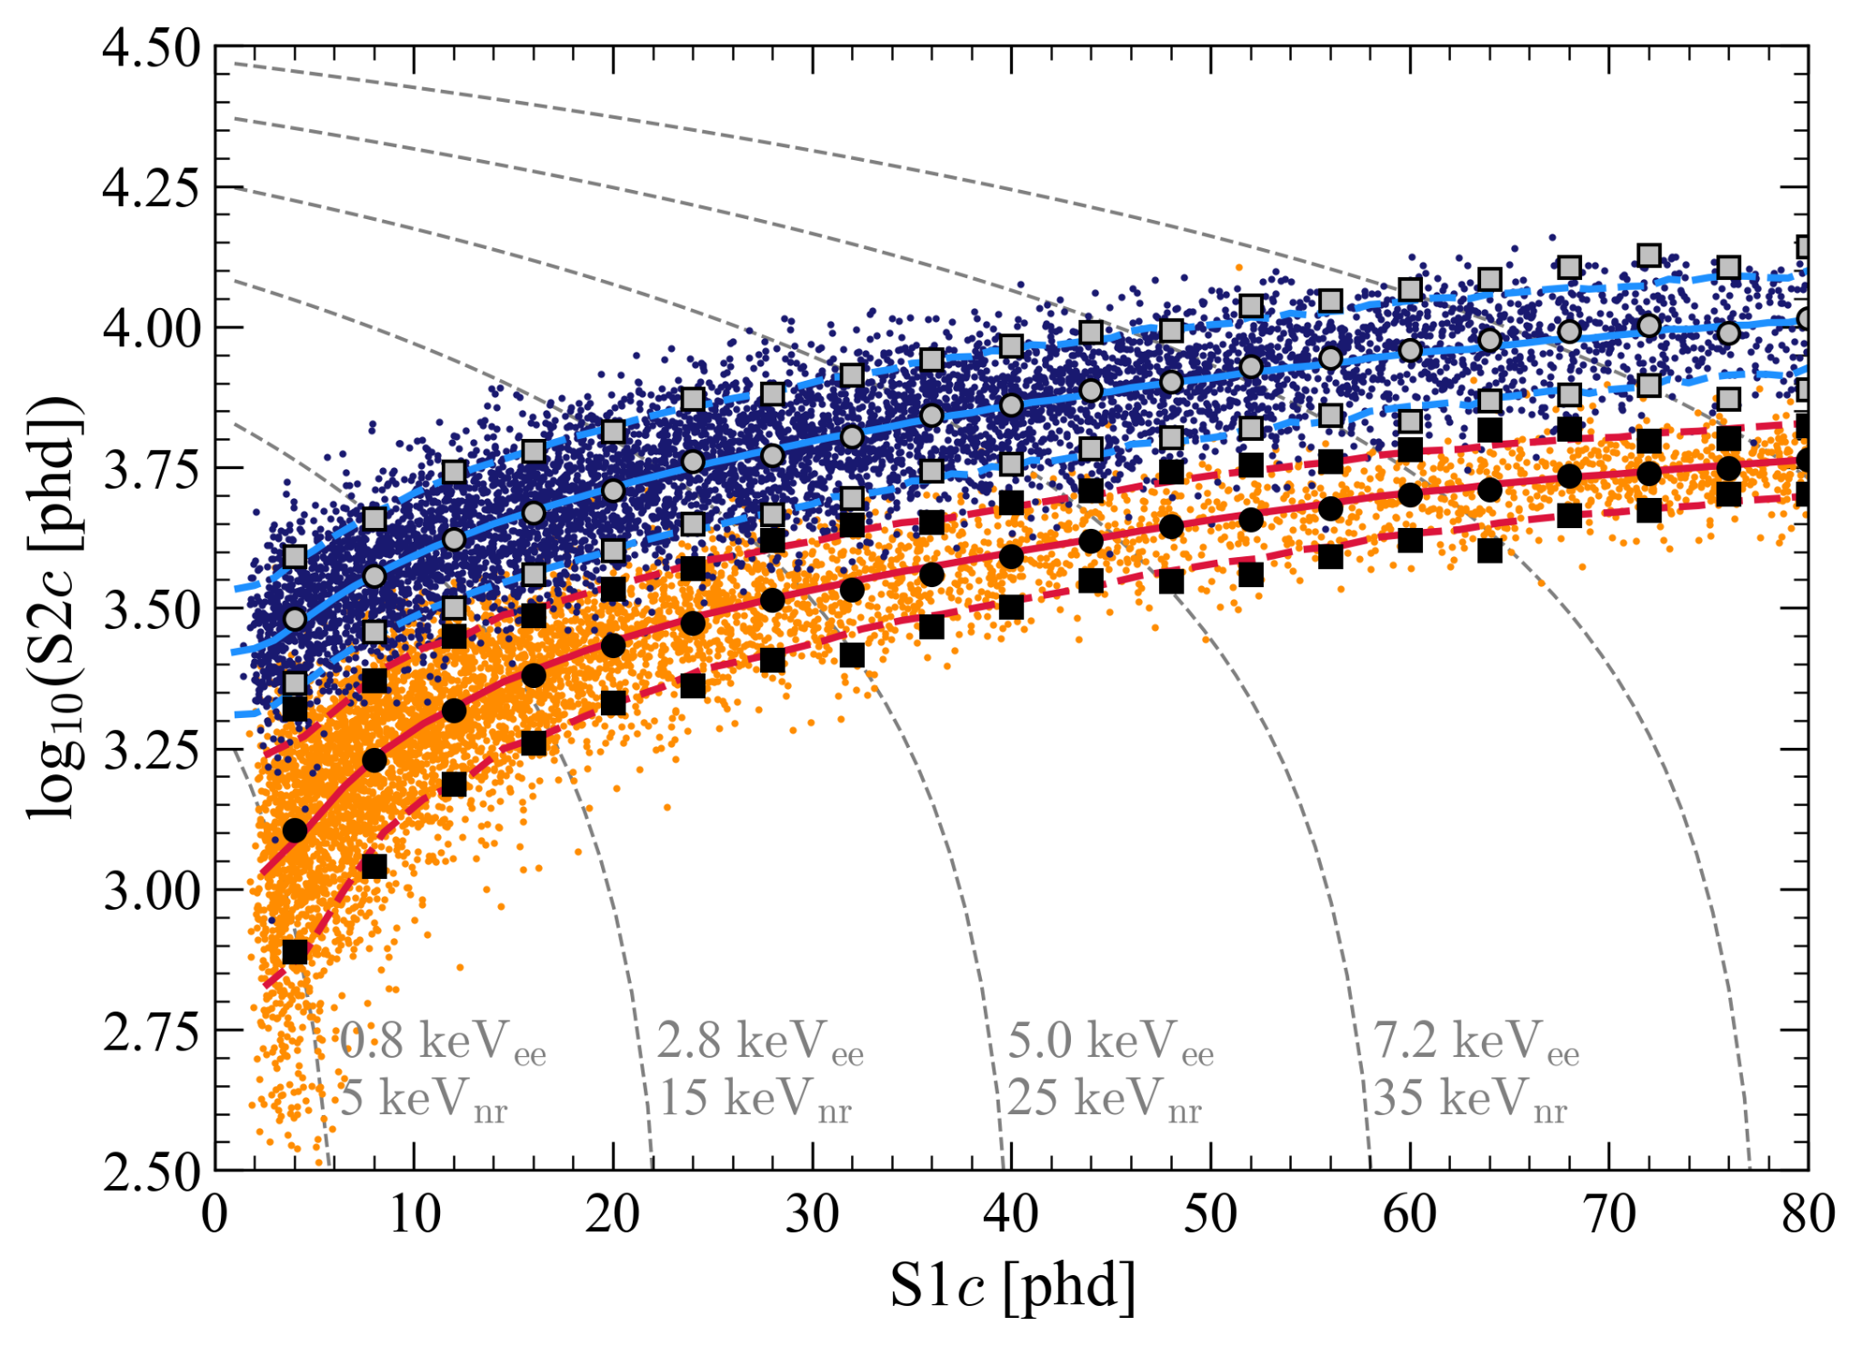
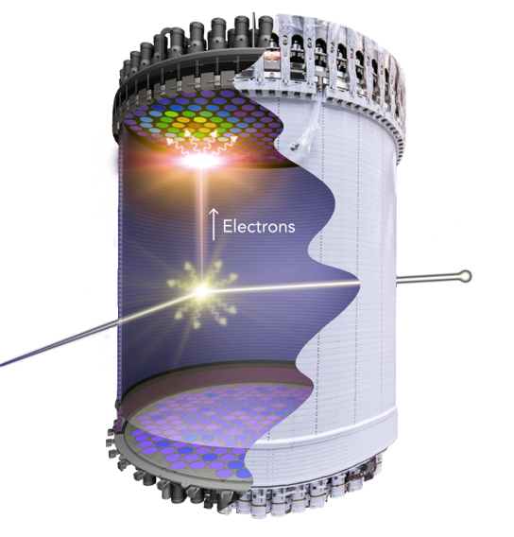
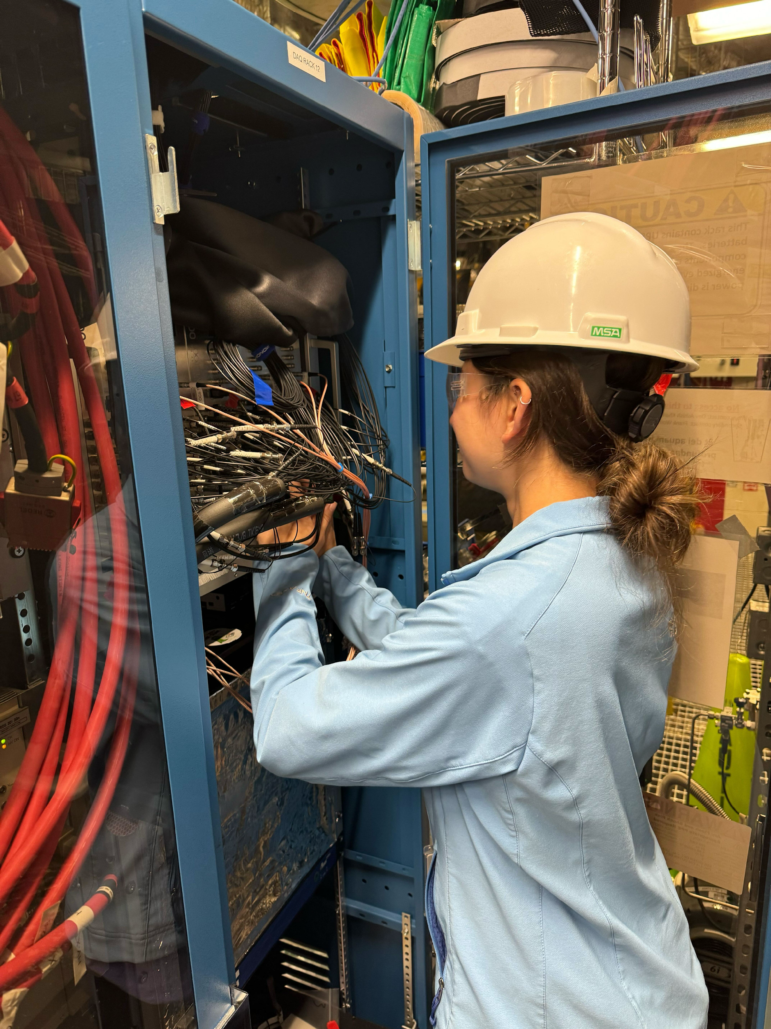
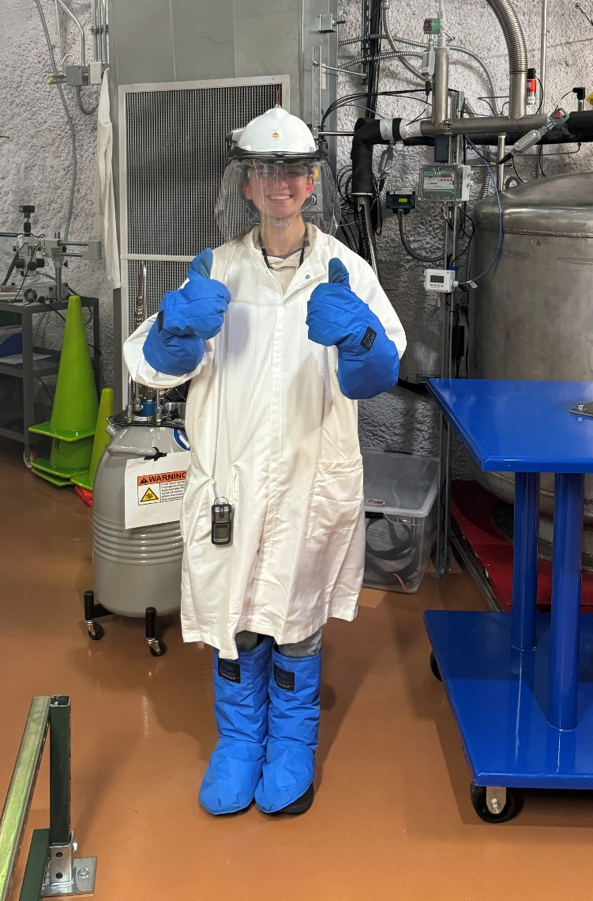
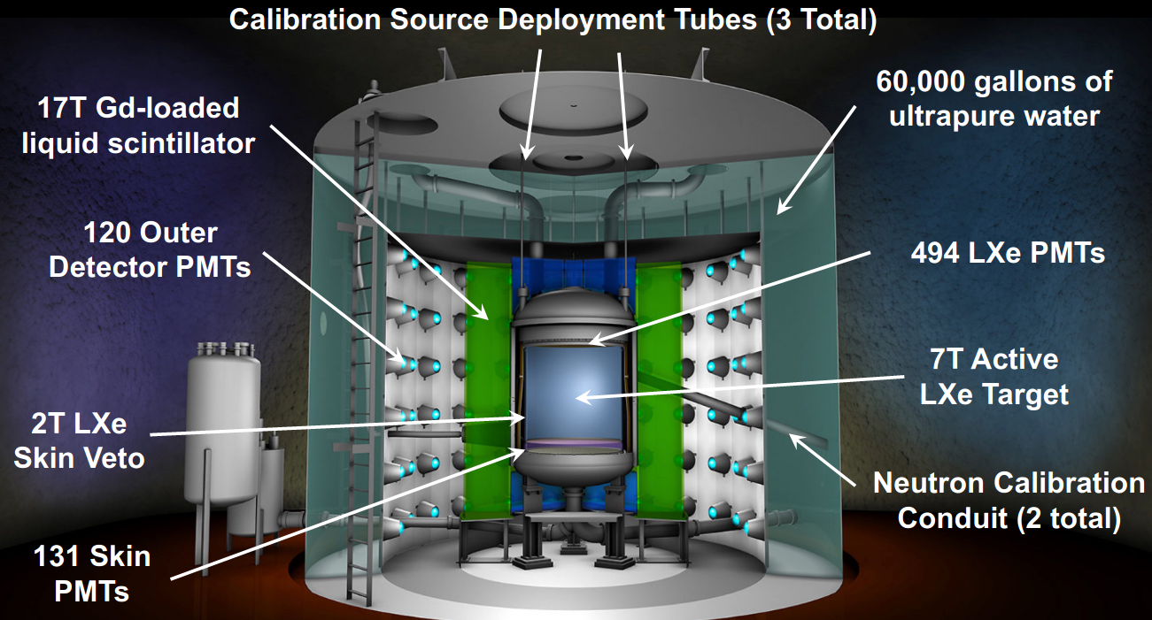
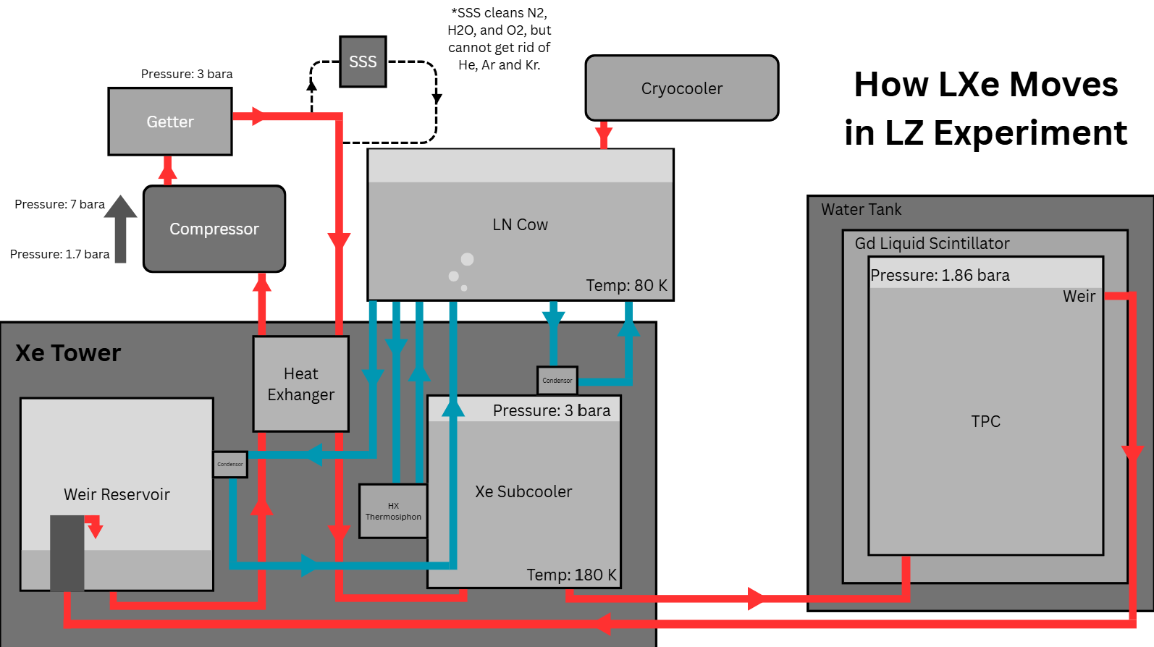
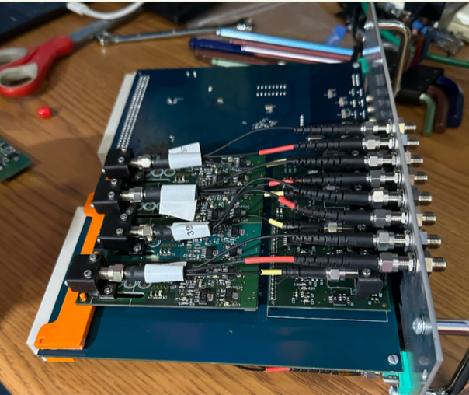
Underground Operations at SURF: Day-to-Day Life and Troubleshooting in the LUX-ZEPLIN Dark Matter Detector
Isabella Lopez¹, George Homenides^{2,3}, Doug Tiedt³
Georgia College & State University¹, University of Alabama², Sanford Underground Research Facility³
Abstract
Methodology
Results
Conclusion
The Sanford Underground Research Facility (SURF) is the deepest underground research facility in the U.S., as it is roughly a mile underground. SURF is multidisciplinary and is home to the most sensitive dark matter detector in the world, the LUX-ZEPLIN experiment.
During my time at the SURF, I was able to gain a variety of skills in hardware, troubleshooting, and day-to-day operations. Throughout these 10 weeks, I have gained hands-on knowledge and experience in a variety of topics detailed below.
How Does LUX-ZEPLIN Detect Dark Matter?
1) WIMP interacts with a single LXe nucleus
2) LXe nucleus excites other nuclei around it.
3) Flash of light occurs, and electrons are knocked off. This is our primary scintillation, S1.
4) Due to electric field, electrons drift towards the top of the TPC.
5) At the top of the TPC there is a thin layer of gaseous Xe; PMTs detect the number of photons set off by the electrons. This is our secondary scintillation, S2.
The time difference between S1 and S2 is max 1ms, and the fraction between S1 and S2 that we see in an event tells us where the event occurred in the TPC.
A Deeper Understanding –
There are two types of signals that LZ will get, electric recoil (ER) and nuclear recoil (NR). Alpha, beta, and gamma particles are all examples of something that would give off an ER signal in the detector. Another key signal of these particles is that they interact more than once, unlike how we believe a WIMP will interact. Nuclear recoil happens for neutrons and WIMPS. NR has a higher electron-ion recombination, which causes a lower S2/S1 rate than ER, despite the strong force being stronger than the electromagnetic force. As shown below is a graph of log(S2c) vs. S1c, with the ER highlighted in blue, and NR highlighted in orange.
What Have I Learned from this Experience?
After 10 weeks at SURF, I’ve developed both technical expertise and personal growth. I moved 5 HPGe detectors from the Davis Campus BHUC to the Ross BHUC, observed and learned about the OD OCS, studied how liquid xenon circulates in the LZ experiment, and gained an understanding of how the TPC detects signals and how data is salted. I built hands-on skills with cryopumping, Xe131m injections, adding attenuators to the DAQ rack, and basic Python programming. Most importantly, this experience deepened my passion for experimental physics, confirmed my interest in national lab research, and strengthened my enjoyment of hands-on troubleshooting and problem-solving.
Fig. 1 -
Map of SURF, detailing where LZ experiment is located. (1)
What Are The Next Steps?
Moving forward, I plan on using the skills I gained, such as Python, equipment knowledge, and troubleshooting to help me continue to further my research during my senior year of undergraduate studies. As well as that, I intend to be applying to graduate schools to deepen my knowledge on particle physics and dark matter. In the future I hope to work in a laboratory setting and get to do hands-on physics and analysis.
Introduction
LUX-ZEPLIN is located at SURF in the Homestake Mine in Lead, South Dakota. During my time as an REU student at SURF, I was able to collaborate and experience a multitude of different parts of life here. Listed below are some of the projects I have contributed to:
Moving 5 HPGe detectors
Building a clean room from ground up and learning procedures
Adding attenuators to DAQ Rack
Performing weekly compressor checks
Learning about how LXe moves in LZ
Thermodynamics and fluid dynamic calculations.
Cryopumping and Xe131m injections
Fig. 3 –
Image of TPC in LZ, demonstrating how the S1 and S2 signals are generated. (2)
Fig 5. –
Graph comparing S2 to S1 signals, with the ER signals highlighted in blue while the NR is highlighted in orange. (1)
Optical Calibration System (OCS) Attenuators –
Within the detector there are many OCS injection points, with 4 being inside the GdLS, 1 inside the acrylic, and many around the PMTs in the array outside of the acrylic tank. These each have cables which connect to pulsar boards that are inside the DAQ rack. These pulsar boards each have another fiber optic cable, for each OCS point, which connect to the monitoring PMT that is inside the DAQ rack. These all connect to an LED. When looking at the data from the fiber optic cables, it became clear that the monitoring PMT was saturated from the fibers. Thus, in order to combat this, it was decided to add attenuators to the fiber optic cables connected to the PMT, to lower the amplitude of the signal coming from each cable.
Thermodynamic Problem-Solving For Leak in Liquid Xe -
From May 18, 2025, to May 22, 2025, the weir reservoir (depicted below) experienced a leak. This was noticed by a difference in the pressure differential between the top and bottom of the weir reservoir. Through using thermodynamic properties, scientists were able to determine the mass of LXe that was lost. Shown below is a diagram of the main lines and how the LN and LXe moves throughout LZ.
Fig. 7 -
Proper PPE necessary to move LN for Xe131m injection.
Fig. 8 – Adding attenuators to monitoring PMT wires for OCS in DAQ Rack
Acknowledgements
I want to thank the NSF for their generous funding of this experience (2150517). I would also like to thank Dr. Brianna Mount, Dr. Doug Tiedt, the LZ crew (George, Julia, Gavin, Alex), and my fellow BHSU/REU recipients for their unending support and guidance throughout the entire experience. A special thank you to SURF for allowing me to work at their facility this summer.
References
Fig. 4 –
Board from DAQ Rack, showing the LED on left part of the board, as well as cables which connect to the monitoring PMT and inside the experiment.
Fig 6 –
This diagram demonstrates how LXe and LN moves throughout LUX-ZEPLIN. The blue lines show the LN moving, cooling down the Xe, and the red lines show the flow of LXe.
(1) Fraser, E. (2024, September 25). Liverpool seminar: WIMP search 2024. LUX-ZEPLIN Collaboration.
(2) Krikler, B.(2019, July 1). The LUX-ZEPLIN Experiment, [PowerPoint Slides].https://lz.lbl.gov/wp-content/uploads/sites/6/2019/09/190702_-LZ-at-PASCOS-2019.pdf
Fig. 2 –
Diagram of the LUX-ZEPLIN experiment, detailing the different sections. (1)

